Slide 1


Slide 2

Version:2023v01

Slide 3


Summary
List of links, 01
Introduction, 02
Background, 03
2.1. Methods for obtaining the subjective value, 04
2.2. Methods for obtaining the discount rate, 07
2.3. Differences in DD tasks regarding hypothetical and real delays and rewards, 08
2.4. Differences in DD tasks regarding hypothetical and real delays and rewards, 09
2.5. Tasks comparisons, 10
2.6. Paper-and-pencil vs. computer-based application, 11
2.7. The current DD tasks, 14
3. Development and functioning of the software, 16
3.1. System requirements, 17
3.2. Opening the software, 18
3.3. General description of the tasks/games, 19
3.4. General administration of the tasks, 21
3.4.1. Registration, 22
3.4.2. Initial Instructions, 22
3.4.3. Points presentation, 23
3.4.4. Choosing an avatar, 24
3.4.5. Presentation of delays, 25
4. Games, 26
4.1. Imaginary Game, 27
4.2. Real Game, 31
4.3. Patience Game, 35
4.4. Reward, 39
5. Output, 40
5.1. Output 1, 40
5.2. Output 2, 42
5.3. Scoring, 44
5.3.1. Randomization, 45
6. User Interface, 48
6.1. Texts, 50
6.2. Prizes (rewards), 51
6.3. Times (delays), 51
6.4. Trainings (practice trials), 52
6.5. Experiments (games/tasks), 53
6.6. Debug, 54
6.7. JSON export, 54
7. References, 56
Apenddix A - Instructions for online administration, 62

Slide 4
01
List of links
First, install the WinRAR application from this link. Next, download the software folder (DD_1.0.3-6.rar) from GitHub using this link. To extract the folder, right-click on it, locate the “WinRAR” option, and select “Extract to ‘DD_1.0.3-6’”;
Access the user interface (Google Spreadsheet) at this link. Create a copy of the user interface and give it a new name;
To obtain the software for Linux and macOS operating systems, please get in touch with the authors.
For additional information on installation, system requirements, and using the software, refer to section 3.2. Opening the software.

Slide 5
02
1. Introduction
The Waiting Game is a free, open-source software of delay discounting (DD). It includes three identical tasks in which language, instructions, delay durations, and reward type/magnitude can be edited by researchers without prior programming knowledge through a user-friendly interface (Google Spreadsheet). These features facilitate its adaptation to various sociocultural contexts and research objectives. The software comprises the following games:
1) Imaginary Game: Delays are hypothetical, and no reward other than points is provided.
2) Real Game: Delays are experienced, and the points gained are converted into a material reward chosen by the experimenter.
3) Patience Game: Delays are experienced, but no reward other than points is delivered.
This User Guide aims to:
1) Provide background information and the rationale for the development of these computerized DD tasks, which incorporate game design elements;
2) Describe the development strategies of the software;
3) Offer instructions on downloading, administering, editing, and obtaining data/scores from the software.

Slide 6

03
2. Background
The preference for immediate rewards over delayed ones is described as choice impulsivity (Hamilton et al., 2015; Stevens et al., 2015). One of the paradigms used to evaluate this kind of impulsivity is Delay Discounting (DD), an intertemporal choice task (Stevens, 2010) that measures how the subjective value of a reward decreases as the time until its delivery increases (Killeen, 2009). Impairments in the ability to delay rewards are prevalent in clinical conditions such as attention-deficit/hyperactivity disorder (ADHD), autism spectrum disorder, conduct disorder, oppositional defiant disorder (Jackson & MacKillop, 2016), gambling, drug abuse, obesity, and others (Odum et al., 2020).
DD tasks typically involve presenting a series of binary choice scenarios in which participants are prompted to choose either a smaller, immediate reward or to wait for a delay to receive a larger reward, as depicted in Figure 1.
What do you prefer?
Tomorrow
Two days
Now Vs.
A week
Two weeks
Figure 1. A DD task comprises a series of trials, each offering the choice between receiving a smaller reward immediately or waiting for a typically fixed delay to receive a larger reward.

Slide 7
04
DD is distinct from Delay of Gratification (DG). In DG, only one choice is made (i.e., receive a marshmallow now or wait to receive two marshmallows), and the test-taker can reverse their choice at any moment during the delay. In contrast, DD involves multiple trials, and test-takers must decide whether or not they are willing to wait before the delay is imagined or experienced (Reynolds & Shiffbauer, 2005).
However, DD tasks used in the literature vary in many respects (Mishra & Lalumière, 2016), as discussed below.
2.1. Methods for obtaining the subjective value
Certain methods for calculating the discount rate involve determining the Subjective Value (SV) of the larger delayed reward. This SV is calculated when the individual reaches a point where they are indifferent between receiving the larger reward after a delay and receiving a smaller reward immediately (Mitchell et al., 2016). For example, if a person chooses to take $10 now instead of waiting for $15 in a month, it suggests that $15 has been subjectively devalued due to the specific delay. Based on this, the SV of the larger reward after the one-month delay is computed as the average of $15 and $10, which equals $12.50 (Killeen, 2009; Tesch & Sanfey, 2008; Myerson et al., 2001).
Nevertheless, there are scenarios where the identical choice option is presented repeatedly during the task, leading to a laborious and time-consuming individual calculation of SV (Staubitz et al., 2018). To streamline the SV computation process, methods have been devised, including the predetermined rules method (Critchfield & Kollins, 2001) and the proportion of delayed reward choices method (Mies et al., 2018).

Slide 8
05
In the predetermined rules method, choices are arranged in ascending order. Table 1 initially presents pairs of choices between the shortest delay and smaller immediate rewards (5s column). The same procedure is applied to the other delays. Choices are coded with the letters D (delayed reward choice) or I (immediate reward choice). The SV of a delay is determined based on a set of rules that assign a value to specific configurations of choice pairs over a given delay. For instance, choices made when the delay was 10 seconds can be represented as DD - DD - DD - II, with a SV of 12.5, calculated as the average between 10 and 15. Corrections are made by two judges who reach a consensus through discussion in cases of disagreement (Scheres et al., 2006).
However, inconsistencies in choices not foreseen by the predetermined rules method may occur (Scheres et al., 2010a), as observed in the sequence II – ID - II - DI depicted in the last columns of Table 1. In these cases, determining the SVs can often be challenging, and the responses may be treated as missing data.
Table 1. Ascending order of choices (trials) of a delay discounting procedure.
Immediate rewards in dollars | Delays associated with the US$ 20 delayed reward
 | 5 s |  |  | 10 s |  |  | 20 s |  |  | 40 s
 | T1 | T2 |  | T1 | T2 |  | T1 | T2 |  | T1 | T2
2 | D | D |  | D | D |  | D | D |  | I | I
5 | D | D |  | D | D |  | D | I |  | I | D
10 | D | D |  | D | D |  | I | I |  | I | I
15 | D | D |  | I | I |  | I | I |  | D | I
Note. T1: trial 1; T2: trial 2; Choices for delayed and immediate rewards are coded, respectively, with the letters D and I. In this example, each delay is made up of choice pairs (T1 and T2).

Slide 9

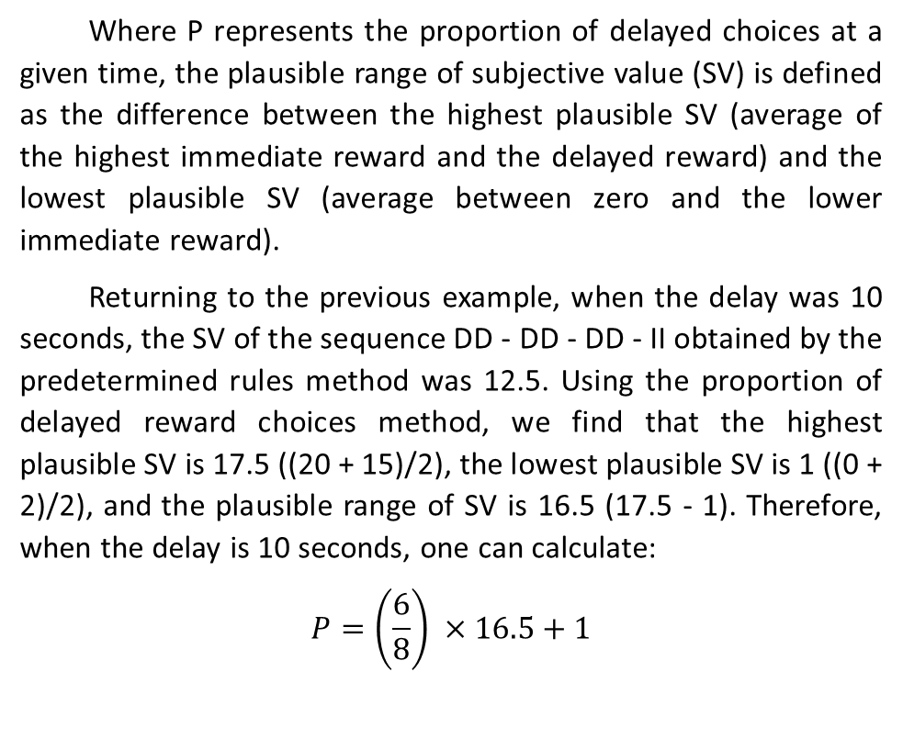
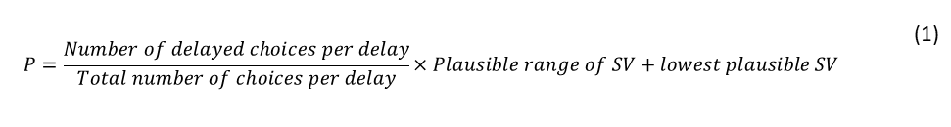
06
Alternatively, it is possible to use the proportion of delayed reward choices method (Mies et al., 2018) because it can be easily automated and is not influenced by inconsistent choice reversals. To calculate it, all choices made in favor of the larger reward at a particular delay are considered, regardless of their presentation order, as shown in Equation 1:
$$P=\frac{Number of delayed choices per delay}{Total number of choices per delay}×Plausible range of SV+lowest plausible SV$$ | (1)
Where P represents the proportion of delayed choices at a given time, the plausible range of subjective value (SV) is defined as the difference between the highest plausible SV (average of the highest immediate reward and the delayed reward) and the lowest plausible SV (average between zero and the lower immediate reward).
Returning to the previous example, when the delay was 10 seconds, the SV of the sequence DD - DD - DD - II obtained by the predetermined rules method was 12.5. Using the proportion of delayed reward choices method, we find that the highest plausible SV is 17.5 ((20 + 15)/2), the lowest plausible SV is 1 ((0 + 2)/2), and the plausible range of SV is 16.5 (17.5 - 1). Therefore, when the delay is 10 seconds, one can calculate:
$$P=\left(\frac{6}{8}\right) ×16.5+1$$
$$P=13.4$$
For the sequence II – ID - II - DI, which might have previously been treated as missing data, the SV is 5.12.

Slide 10
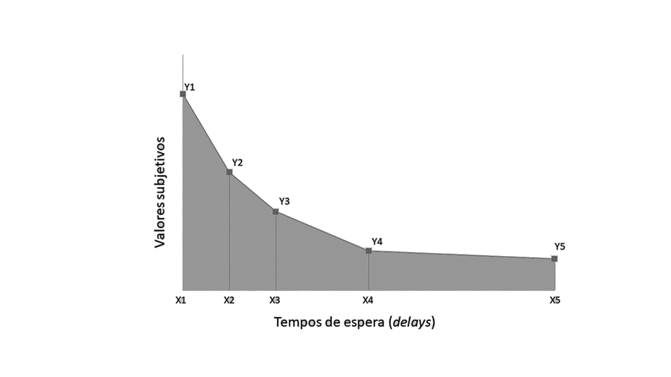

07
2.2. Methods for obtaining the discount rate
The discount rate of a reward over time is well explained by a hyperbolic function (Peters et al., 2012; van den Bos & McClure, 2013), and there are two primary methods to determine it. The first method involves calculating the parameter k, which describes how the value (V) of a reward (A) decreases as a function of time (T) based on the slope of the discount curve (Mazur, 2000). Consequently, a steeper slope indicates higher impulsivity (Beck & Triplett, 2009). The parameter k can be calculated using Equation 2:
The second method involves calculating the area under the curve (AUC; Myerson et al., 2001), which is determined based on the SVs of the choices made by the individual for each delay (Reynolds, 2006). To achieve this, the SVs of test-takers are plotted on a graph, with delays arranged on the X-axis and SV on the Y-axis. Figure 2 displays the subjective value of the larger reward as a function of progressively longer delays, which are used to calculate the AUC. A higher AUC value indicates lower discounting or lower impulsivity.
 | $$V=\frac{A}{\left(1+k.T\right)}$$ | (2)
Figure 2. Illustrative graph of the discount function using the area under the curve (AUC) method, where “x” corresponds to the delays and “y” represents the subjective values of the larger devalued reward over time. To calculate the AUC, the areas of the trapezoids (highlighted in gray) are computed and summed using Equation 3.
Subjective value of the larger reward
AUC
Delays

Slide 11
08
As depicted in Figure 2, the points corresponding to SVs are connected, and a vertical line is drawn from each SV to its corresponding waiting time on the X-axis, forming trapezoids. Subsequently, the area of each trapezoid is calculated and summed using the equation (Myerson et al., 2001):
Through this procedure, an index of impulsivity can be determined, which has lower and upper limits. This approach is suitable for assessing non-normal data, which is common in the evaluation of human choice behavior (Reynolds, 2006).
 | $AUC=\left[\left(x2−x1\right).\left(\frac{y1+y2}{2}\right)\right]+\left[\left(x3 – x2\right) . \left(\frac{y2 + y3}{2}\right)\right]+…$ | (3)
2.3. Differences in DD tasks regarding hypothetical and real delays and rewards
DD tasks involve two primary parameters: delay and reward. These parameters can be either hypothetical or real, as outlined in Table 2.
Table 2. Possible combinations between the parameters (delay and reward) regarding the condition (hypothetical and/or real) with which they are presented in each delay discounting task.
 | Tasks
Parameters | Hypothetical¹ | Real-time² | Real-reward³ | Hypothetical with temporal expectation⁴
Delay | Only imagined | Experienced | Only imagined | Experienced
Reward | Not delivered | Delivered | Delivered based on probabilities | Not delivered
Note. ¹⁻³Task names as referred by Reynolds (2006); ⁴Task name as referred by Utsumi et al. (2016).

Slide 12
09
According to Reynolds (2006), there are three common combinations of parameters in DD research:
1) Hypothetical delays/rewards (referred to as a hypothetical task), where delays are imagined, real rewards are not delivered, and only points are gained.
2) Real delays/rewards (real-time task), where delays are experienced, and real rewards are provided (e.g., money).
3) Hypothetical delays/real rewards (real-reward task), where delays are hypothetical, and all rewards chosen during the task, except one, are randomly selected and delivered, similar to a lottery system. This assumes that the potential gain of one reward guides test-takers to choose as if all rewards were real.
Additionally, there is a fourth combination: Real delays/hypothetical rewards (hypothetical with temporal expectation task), discussed in Chapter 4, Section 4.3. Patience Game.
2.4. Differences in DD tasks regarding length of delays and type/magnitude of rewards
Aside from involving hypothetical and real delays and rewards, DD tasks can also differ in terms of the timeframes used to measure delays and types or amounts of rewards.
Frequently, hypothetical and real-reward tasks involve longer. delays (days, weeks, and years) and higher rewards, sometimes reaching hundreds of dollars. On the contrary, real-time tasks typically involve shorter delays, ranging from seconds to a few minutes, and offer smaller rewards, often limited to a few US dollars or other items of relatively low financial value (see Reynolds, 2006; .. Jackson & MacKillop, 2016). This distinction

Slide 13
10
arises due to the challenges of conducting real experiments with large groups of participants (Matusiewicz et al., 2013; Robertson & Rasmussen, 2018).
Regarding the types of rewards, traditional DD tasks often involve monetary gains because money is a lasting and easily measurable commodity (Glimcher et al., 2009). Nonetheless, other durable items, like objects, have also been utilized and demonstrate discounting patterns akin to those observed with cash rewards (Demurie et al., 2013). In contrast, consumable rewards such as food and cigarettes tend to demonstrate a more pronounced discounting pattern compared to money (Staubitz et al., 2018), making them more suitable for specific populations like individuals with eating disorders or smokers.
2.5. Tasks Comparisons
Studies aiming to directly assess the association between DD tasks often overlook one or more of the factors mentioned above. These variations introduce additional sources of variability in research, making it challenging to make consistent comparisons between DD tasks or identify the specific cognitive abilities involved in the decision-making (Ernst, 2014).
For example, two influential studies have indicated task equivalence between hypothetical and real-reward conditions in adults. They utilized identical delays of up to six months and rewards of up to US$ 10 per trial for both tasks (Johnson & Bickel, 2002; Madden et al., 2004). However, it is crucial to acknowledge that probabilistic procedures deviate from the dynamics of DD and .may not accurately represent behavior

Slide 14
11
in scenarios where real gains are unaffected by luck or the risk of loss (Green et al., 1999; Kahneman, 2012).
Therefore, it is not feasible to confidently claim, based on these studies, that performance in a real-reward task corresponds to that in a hypothetical task or aligns with a real-time task where delays are experienced, and rewards are genuinely received, regardless of probabilities.
Research comparing performance in hypothetical and real-time tasks is limited and has produced conflicting outcomes. These disparities may be attributed to various factors, including the age range of participants, sample size, the number of task trials, participants' health conditions, and the methodology employed for discount rate computation. For instance, Scheres et al. (2010a) observed similar performance in healthy 18-19-year-olds when comparing hypothetical and real-time tasks, each involving 40 trials with precisely matched delays (up to 60 seconds) and rewards (maximum of US$ 0.10 per trial) while employing the AUC as the DD index. However, within the same study, performance diverged when examining a version of the hypothetical task featuring larger rewards (e.g., US$100) and extended delays (e.g., 120 months) in contrast to hypothetical and real-time tasks with smaller values and shorter delays. This suggests that the nature of hypothetical and real-time tasks can vary depending on the magnitude of the parameters involved.
On the other hand, Miller (2019) did not observe equivalence between hypothetical and real-time tasks, despite using the same short delays and small rewards for both tasks. However, his study involved only five trials to assess nine

Slide 15
13
children aged 7 to 10 years with impulsive characteristics, using the parameter k as a measure of discount. Lagorio and Madden (2005) found AUC equivalence between similar but not identical hypothetical and real-time tasks, featuring longer delays and larger rewards (exchangeable for food or drink) in only six healthy participants aged between 19 and 20 years. Moreover, the number of trials was not predetermined. Lastly, Lane et al. (2003) discovered differences in the performance of healthy participants aged between 19 and 37 years in hypothetical and real-time conditions that did not align in terms of scales used to measure delays and rewards, using the parameter k.
Hence, in healthy adults, there is controversy regarding the comparability of performance in hypothetical and real DD tasks, and there is a scarcity of studies comparing hypothetical and real-time tasks where delay lengths and reward magnitudes were matched. Even more limited is our knowledge about the performance of typical adolescents in these tasks.
2.6. Paper-and-pencil vs. computer-based application
Hypothetical DD tasks can be administered through paper-and-pencil questionnaires or using automated tasks, both of which are considered equivalent to obtain a discount rate (Smith & Hantula, 2008). However, non-automated administration and scoring can lead to errors. Automation offers better data management, organization, and pre-processing capabilities, as responses are automatically recorded, and scoring algorithms and equations can be integrated into the program's script (Paul et al., 2005). Additionally, computer-based tasks have the advantage of requiring fewer evaluators to assess a larger

Slide 16
14
number of participants (Schneider, 1991). Furthermore, automated tasks can enhance motivation through gamification (Turan et al., 2006; Sailer et al., 2017), which involves using game design elements in non-game contexts (Deterding et al., 2011; p. 10). Gamification also reduces task anxiety (Cerrato & Ponticorvo, 2017), which is important because it is known that individuals with low motivation and anxiety may not perform at their full potential (Edwards et al., 2015).
Hence, comparing performance in hypothetical and real-time DD tasks benefits not only from enabling the matching of delay times and rewards but also from using automated DD administration, as demonstrated by the program developed here, which was designed for testing DD in adolescents.
2.7. The current DD tasks
In summary, conflicting results exist regarding performance in real-time and hypothetical DD tasks, and real-reward tasks introduce probabilities that differ from the original hypothetical tasks. To address these issues, we crafted a DD software featuring visually identical tasks with aligned delays and rewards.
The computer-based approach was chosen to prevent application and scoring errors (Paul et al., 2005), with algorithms integrated into the program script for calculating subjective values via the proportional method (Mies et al., 2018) and the area under the curve (Myerson et al., 2001). These methods are easy to automate and suitable for handling

Slide 17
15
inconsistent choices and non-normal data (Reynolds, 2006). Incorporating game design elements into the software enhances motivation (Lumsden et al., 2016) and reduces test-related anxiety (Cerrato & Ponticorvo, 2017), which can impact performance (Martin & Franzen, 1989; Edwards et al., 2015).
Furthermore, the software is open-access and editable, allowing researchers with limited resources to use it and customize it for experiments in diverse sociocultural contexts (Staubitz et al., 2018). Given that previous DD studies primarily involved samples from developed nations, providing tools for studying DD in different countries is crucial to assess the generalizability of DD performance patterns across diverse populations.

Slide 18
16
3. Development and functioning of the software
The Waiting Game was developed with adolescents in mind, drawing inspiration from the research of Scheres et al. (2006; 2008; 2010a, 2010b; 2014), Demurie et al. (2013), and Utsumi et al. (2016). It features three distinct DD games: 1) Imaginary Game (Hypothetical delays/rewards or hypothetical task); 2) Real Game (Real delays/rewards or real-time task); 3) Patience Game (Real delays/Hypothetical rewards).
This software was developed using Unity3D (version 2018.2.21.fl) to provide a video game-like experience. The coding was done in the Rider IDE, and we created visual elements using GIMP and Photoshop. While most of the code is written in C# (C-Sharp), there's a user-friendly interface (UI) for researchers. This UI allows them to create new configuration files using Google Spreadsheets, and a JavaScript script converts the data sheet information into code.
The UI was designed based on the principles of Model-Driven Game Development, allowing users to modify the software through Google Spreadsheets. This acts as a modeling tool, generating a new script file in JSON format, which is widely used in various software applications. This approach enables users to handle program versioning through models (the spreadsheet) while keeping the generated code untouched (Kelly & Tolvanen, 2008, p. 308).

Slide 19
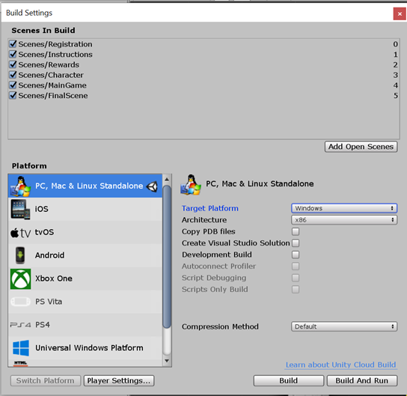
17
The software's user interface (UI) allows text editing and offers a selection of default language options (English, Brazilian Portuguese, or Spanish). Additionally, users can add a new language and modify parameters like reward magnitude and type, as well as delay lengths.
3.1. System requirements
The Waiting Game is compatible with Windows 7 (SP1+) and later versions. It is installable on computers, notebooks and tablets. The binaries included were only for Windows x64, however, because Unity is built on top of Mono, users can quickly recompile the project for any Operating System that is supported by Unity, such as macOS High Sierra 10.13+, and Linux Ubuntu 20.04 and later versions (Figure 3).
Figure 3. To compile the project on your own, first, download Unity Hub and install Unity version 2018.x (any 2018 version should work). Then, open the folder containing the source files in Unity and navigate to File > Build Settings.

Slide 20
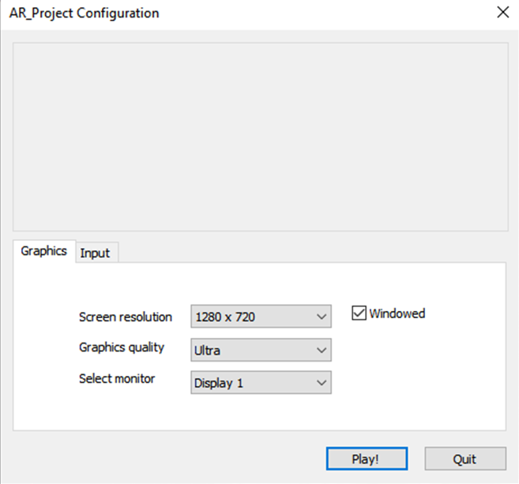
18
3.2. Opening the software
i) Download the zipped folder from GitHub (DD_1.0.3-6.rar) here, assuming you have WinRAR installed. To unzip the folder, right-click on it, find the “WinRAR” command and select “Extract to 'DD_1.0.3-6'”. Afterwards, you can move the folder to the preferred directory. Click here and make a copy of the user interface (Google Sheets) and give it a new name. Access the source code clicking here. For downloading the software on Linux and macOS operating systems, please get in touch with the authors.
ii) Within the unzipped folder, find the executable file (AR_Project) and run it.
iii) A dialog box will appear, offering choices for screen resolution and graphics. If you prefer the program to run in a window, click "Windowed." Otherwise, click "Play!" to launch the game in full screen mode. To exit full screen, you can use the following key combinations: ALT + F4, ALT + TAB, or WINDOWS + D (see Figure 4).
Figure 4. Most modern computers should be able to handle the "Ultra" quality settings without issues. However, if you encounter any problems, you can choose a lower configuration.

Slide 21
19
3.3. General description of the tasks/games
In each game/task, participants are asked to choose between immediately receiving a lower reward (i.e., 100, 400 or 700 points with no delay) or waiting for varying delays (i.e., 7, 15, 30 or 60 s) to receive a higher reward (1000 points). These points and delays were chosen based on prior research involving underaged participants (Scheres et al., 2014; Utsumi et al., 2016), but all these parameters can be altered as explained in Chapter 6. User Interface regarding software editing.
In the literature the number of trials can vary, but it is common to repeat the same pairing of delay and reward (e.g., choosing between 400 points immediately or waiting 15 seconds for 1000 points) more than once (Patros et al., 2016).
In the Waiting Game, each lower reward is paired with each delay three times, excluding zero time. For example, the choice between immediately receiving 100 points and waiting 7 seconds for 1000 points is presented three times during each game. Therefore, for each delay, there are 12 possible pairings with immediate rewards, resulting in a total of 36 trials per game. Points are used as rewards, and in the case of real rewards, more points within certain ranges can be converted into higher monetary values (see Utsumi et al., 2016), which can be determined by experimenters.
The visual layout of the software was designed with adolescents in mind. To emulate the typical style of video games, the program uses icons and images instead of text wherever possible, and written instructions are kept to a minimum.

Slide 22
20
Delays, rewards and total scores are always displayed in the same spatial locations to reduce cognitive demands. This approach takes advantage of the fact that individuals tend to implicitly learn environmental patterns, making it easier for them to make predictions (e.g., Garrido et al., 2016). By maintaining this consistency, we prevent disruptions in these learned patterns, allowing test-takers to concentrate on the demands of the DD tasks.
Additionally, for tasks involving real delays, participants are represented by avatars designed in a manga style, which is a popular Japanese graphic novel (comic) and anime style known worldwide (Majaw, 2015; Alt, 2020). This aesthetic style is commonly found in video games and is particularly appealing to adolescents. We aimed to leverage this appeal to enhance motivation for completing the DD tasks, even among clinical populations (e.g., individuals with autism spectrum disorder; Rozema, 2015). The software offers a selection of four manga characters as avatars (two female, one male and one androgynous) to allow for sex/gender identification (see Trepte & Reinecke, 2010).

Slide 23
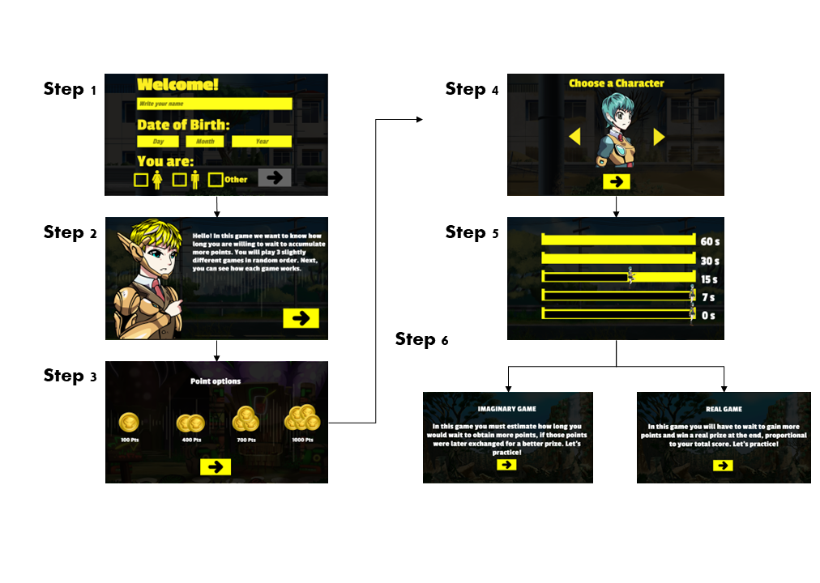
21
3.4. General administration of the tasks
The software administration comprises six steps outlined in Figure 5, which will be elaborated upon below:
Tasks in random order
Figure 5. This figure illustrates the steps when running the software: 1) Registration; 2) Initial instructions; 3) Presentation of points; 4) Choosing an avatar; 5) Presentation of delays; and 6) Games, presented in random order: Imaginary Game (hypothetical task), Real Game (real-time task) and Patience Game (hypothetical with temporal expectation).

Slide 24
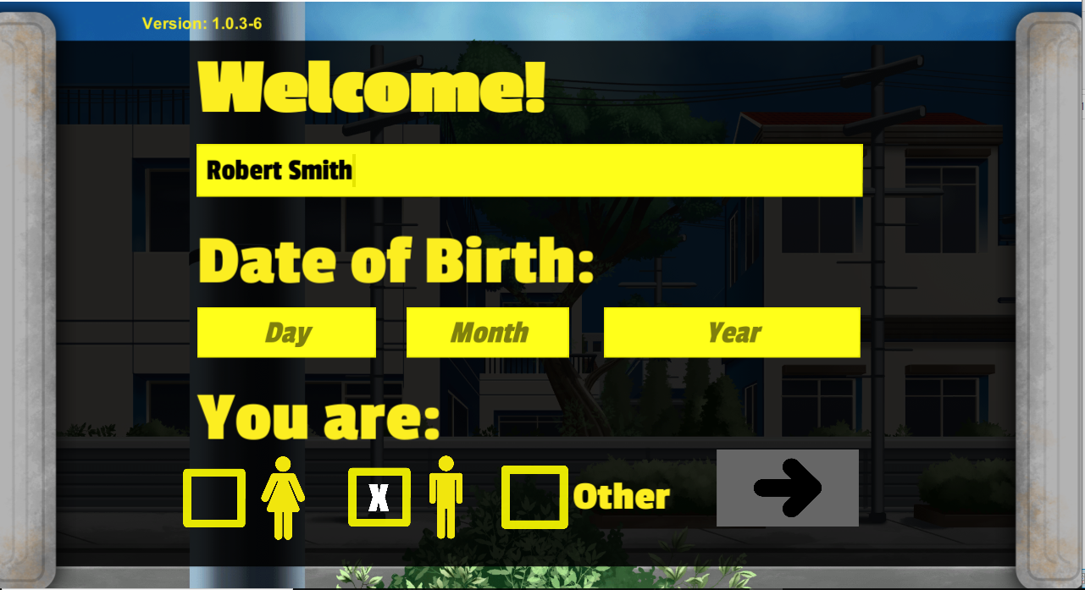
22
3.4.1. Registration
In this screen, the test-takers are asked to enter their full name, date of birth (dd / mm / yyyy) and gender/sex. The "Other" choice is provided for individuals who do not identify as male or female. Once the required information is entered, test-takers can advance by clicking on the ARROW (next) positioned in the lower right corner (Figure 6). For those interested in a shortened demonstration of the program's features, entering "debug" in the Name field will bypass the need to wait for any delays.
Figure 6. Registration screen.
3.4.2. Initial Instructions
This screen provides fundamental textual information about the DD tasks (Figure 7). In case of any questions or uncertainties, additional verbal explanations can be provided, such as: “In this activity, you will make several choices between receiving fewer points immediately or waiting for some time to receive more points. The longer you. wait, the more points

Slide 25
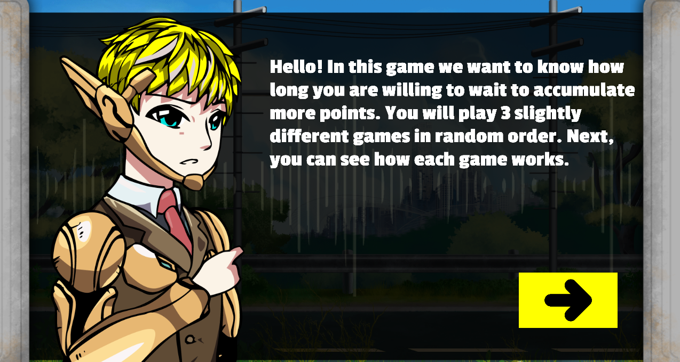
23
you will accumulate. In just one of the games, the points you accumulate will be converted into real prizes [please specify the prize]. The more points you score, the better your chances of receiving a better prize. Before each game, you will be informed if you will receive a prize, okay?”
Figure 7. An editable screen that provides fundamental textual information about the activity.
3.4.3. Points Presentation
In this screen (Figure 8), the point options (100, 400, 700, and 1000) are displayed from left to right in ascending order of magnitude. These options can be modified using the user interface.

Slide 26


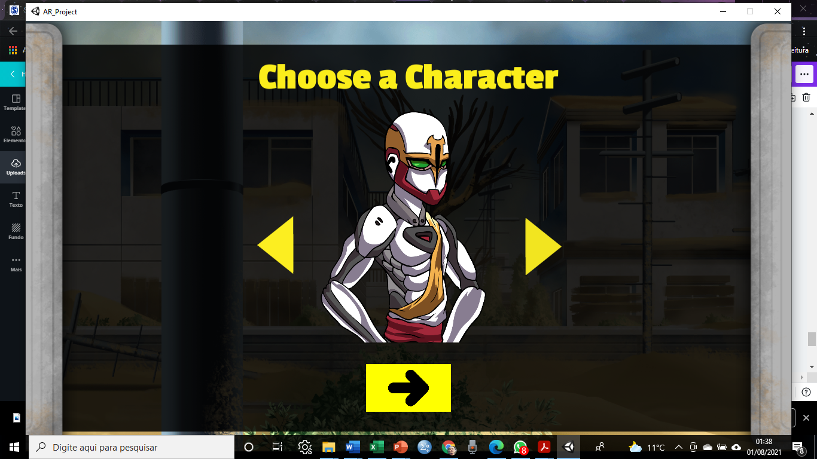
24
Figure 8. Point options, which can be modified using the user interface.
3.4.4. Choosing an avatar
In this screen, the test-taker selects an avatar, a character, from the four available options, to represent him/her in all the games (Figure 9). To browse through the avatars, the test-taker can click on the left or right-pointing triangles. Once the desired avatar is visible, the test-taker can proceed by clicking the arrow located below the chosen avatar.
Figure 9. Avatar selection screen (above). To browse through the options and select one of the four avatars on the left, simply click the right or left-pointing triangles, and then click on the ARROW located below the chosen avatar.

Slide 27

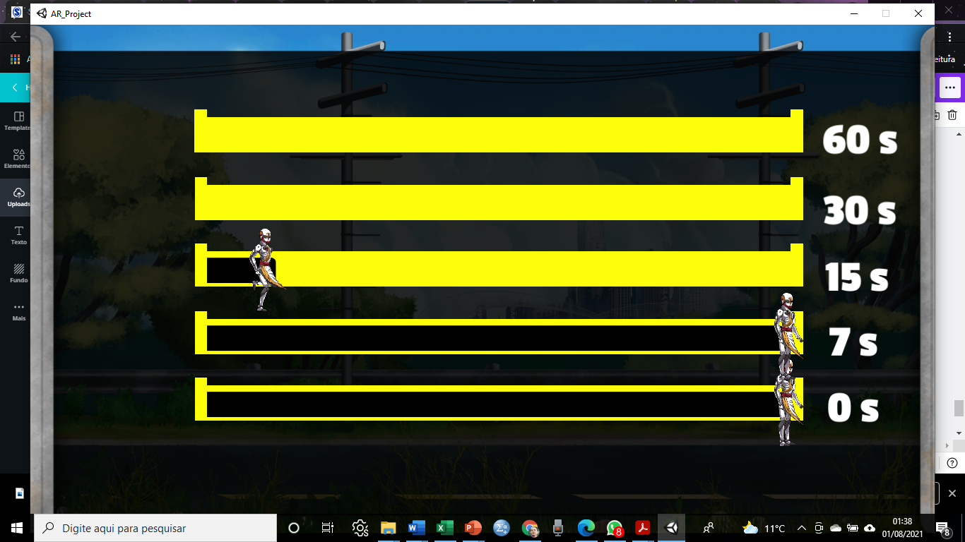
25
3.4.5. Presentation of delays
This step is designed to familiarize test-takers with the durations of the delays used in the games. It consists of two screens: the first (Figure 10A) provides information that some delays will be presented, and the second (Figure 10B) displays the delays as five horizontal lanes on the screen, stacked from top to bottom: 60, 30, 15, 7, and 0 seconds. The chosen avatar starts in the bottom lane (representing zero delay) and moves from left to right in 0.5 seconds, serving as a speed reference. Subsequently, the avatar appears positioned on the far left of the lane immediately above the bottom one and moves to the far right in 7 seconds, and so on. Test-takers are encouraged to experience all delays to establish a real-time reference for their choices.
A
Figure 10. (A) Screen providing information about the delays that will be part of the tasks and will be presented/experienced.
(B) This screen displays all the delays that will be part of the tasks, starting with zero seconds (referring to the immediate reward). The chosen avatar crosses the lane in 0.5 seconds. Then, in the lane immediately above, the avatar crosses the lane in 7 seconds, and so on.
B

Slide 28
26
4. Games (see Appendix A for online administration)
IMPORTANT:
The Waiting Game includes three games (tasks) presented in random order. Trials are arranged in a pseudo-random order, with changes in sequence for each administration;
Each game is preceded by 8 practice trials. In the actual games, each immediate reward is paired three times with each delay. With three immediate rewards and four delays (except for zero seconds), each game comprises 36 trials;
Before each game, we recommended providing verbal instructions in addition to those presented in writing;
3) Before the start of each game, verbally inform the test-taker whether or not they will receive any material reward or prize;
4) The examiner should maintain a neutral stance and closely observe the test-taker's behavior. During waiting periods, some individuals may try to engage in conversation, stand up, or use their cell phones. Therefore, instruct the test-taker to remain silent, seated, and to turn off their cell phones while playing. The examiner should speak only when necessary and encourage the test-taker to focus on the game. Avoid making comments that could influence the test-taker's choices. If the test-taker has questions, respond briefly and objectively. If the test-taker becomes impatient, they should be allowed a short break of approximately 5 minutes between games. If the test-taker inquires about the duration of the task, inform them that the entire activity lasts from 15 to just over half an hour. During the games, it is advisable for the examiner to maintain some distance from the test-taker to minimize the feeling of being observed;
5) Discontinuation criteria: 1) if the test-taker expresses a desire to withdraw from the activity; 2) if there is a noticeable lack of understanding of instructions; 3) if negligence and carelessness with the activity reach a point where data collection becomes infeasible due to aggressive, offensive, and/or destructive behavior.

Slide 29
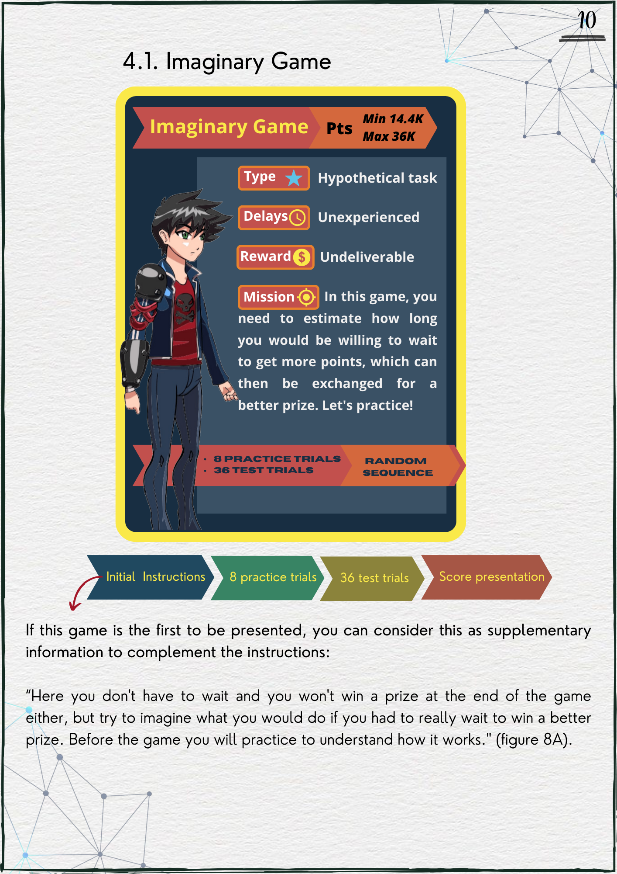
27
4.1. Imaginary Game (hypothetical delays and rewards)
“In this game, there's no need to wait, and you won't receive a prize at the end of the game. However, try to imagine what you would do if you had to wait to receive a better prize. Before the game begins, you will have the opportunity to practice and understand how it works.” (Figure 11A).

Slide 30
28
If this game is the second or third to be presented, the examiner can say:
“In this game, unlike the last one (or the others), try to imagine if you would wait longer to accumulate more points. Here you will NOT receive a material prize, but make the choices as if you were going to receive one. Let's practice." (Figure 11A).
Figure 11B displays one of the practice trial screens. To enhance understanding, the following can be explained:
“Now, you are going to practice. You will see screens like this one, where you need to choose if you prefer to wait some time to accumulate a higher score or if you prefer to accumulate a lower score immediately. To make your choice, simply click on the points you want, and they will appear on the scoreboard [point to the scoreboard]. Each time you make a choice, the points will be added to the previous ones and will show up here [on the scoreboard]. See how it works.”
Using Figure 11B as an example, you can say:
“Take a look at this screen: we have 400 points here, which you can accumulate now, and 1000 points in this other lane, which you will accumulate after waiting 15 seconds [point to the corresponding lanes]. In this game, you don’t actually have to wait, but it’s essential to imagine if you would wait to accumulate more points and receive a better prize or not.”
Even if the test-taker understands the instruction, they may still need encouragement to proceed with the practice trials.

Slide 31

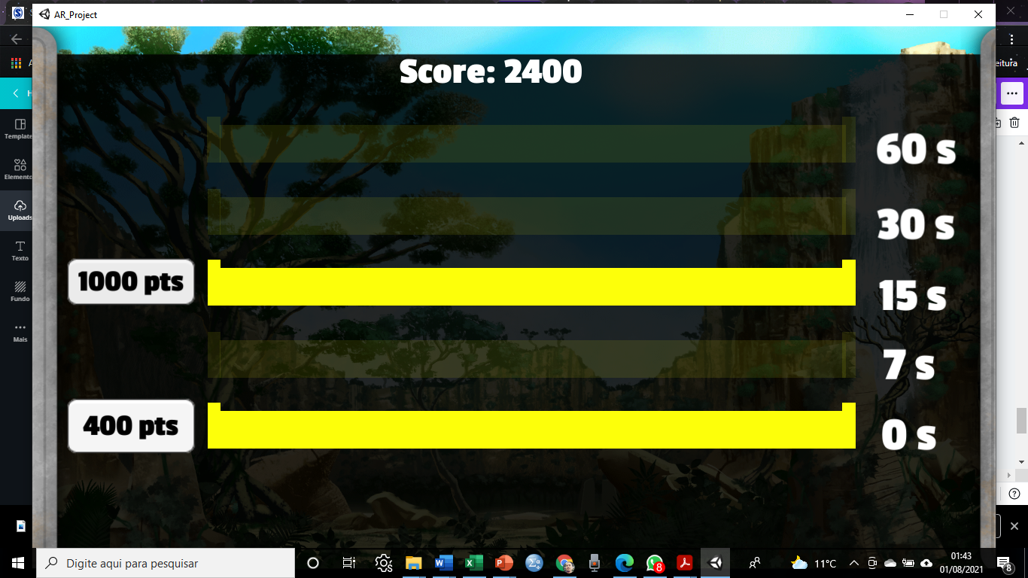
29
A
B
Figure 11. (A) Basic instructions for the Imaginary Game; (B) Practice screen in which the test-taker must choose between waiting 15 seconds to accumulate 1000 points or receiving 400 points immediately. As it is a hypothetical task, it is important to emphasize that the time intervals are not experienced, and the test-taker will not receive a material reward at the end of the game.

Slide 32

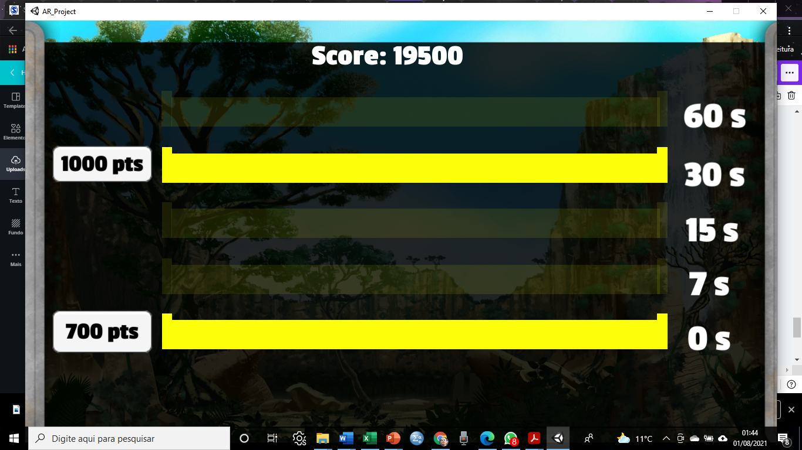

30
After practicing, the first Imaginary Game screen appears, and it is essential to ensure that the task-takers understand their task. If necessary, repeat the instructions in a different way. Then, remind the test-takers that they will NOT receive a material reward at the end of the game (Figure 12A). At this point, the examiner can say:
“Now that you have practiced, you can play the game. Remember, in this game, you will NOT receive a material prize, but make your choices as if you were going to receive one. You can start."
A screen similar to the one shown in Figure 12B then appears. All games have the same layout, with the only difference being that in the Imaginary Game the avatar does not cross the lane. Instead, by clicking on the desired score, the next trial (choice screen) is presented. After 36 trials, a screen appears showing the total score achieved in the game (Figure 12C).
A
B
C
Figure 12. Sequence of steps for the Imaginary Game test. (A) A screen that informs the start of the Imaginary Game and emphasizes that the test-taker will not receive a material prize. (B) An example of an Imaginary Game trial where the test-taker must imagine their willingness to wait for a certain amount of time (e.g., 30 s) to receive a higher score (1000), which could correspond to a higher hypothetical prize, or receive a lower score (700 points) immediately.
(C) Final screen displaying the final score in the Imaginary Game.

Slide 33
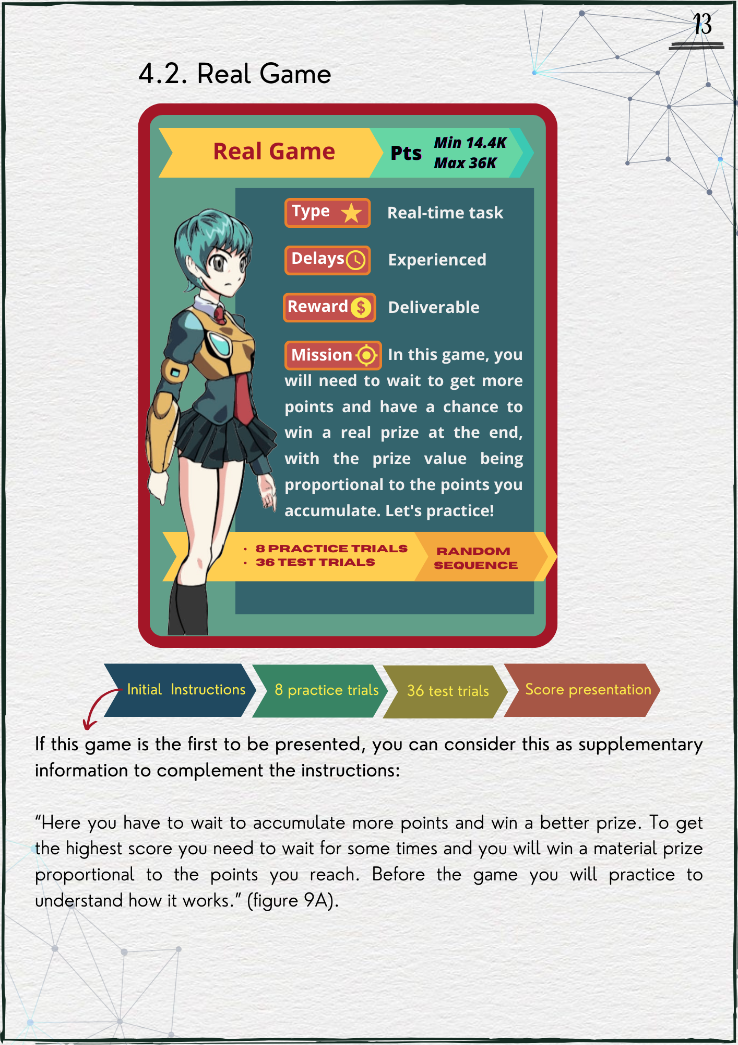
31
4.2. Real Game (real delays and rewards)
"In this game, you need to wait to accumulate more points that will be exchanged for a real prize at the end. To get more points, you must wait for different time intervals. Your material prize will be proportional to the points you accumulate. Before the game begins, you will have the opportunity to practice and understand how it works.” (Figure 13A).

Slide 34
32
If this game is the second or third to be presented, the examiner can say:
“In this game, unlike the last (or others), evaluate your willingness to actually wait to accumulate more points. Here you WILL receive a material prize proportional to the points you reach at the end. Let’s practice!” (Figure 13B).
Figure 13B shows one of the practice screens. As a way to complement the instructions, the following can be said:
“Now, you are going to practice. You will see screens like this one, where you need to choose if you prefer to wait some time to accumulate a higher score or if you prefer to accumulate a lower score immediately. To make your choice, simply click on the points you want, and they will appear on the scoreboard [point to the scoreboard]. Each time you make a choice, the points will be added to the previous ones and will show up here [on the scoreboard]. See how it works.”
Adopting Figure 13B as an example, you can say:
"Take a look at this screen: we have 100 points here [after choosing, the points are shaded], which you can accumulate now, and 1000 points in this other lane, which you will accumulate after waiting 7 seconds [point to corresponding lanes]. In this game, if you press that button [corresponding to the larger reward], you will need to really wait, in this case, for 7 seconds. Remember, the more points you accumulate, the bigger the prize you’ll get at the end.”
Even if the test-taker understands the instruction, they may still need encouragement to proceed with the practice trials.

Slide 35

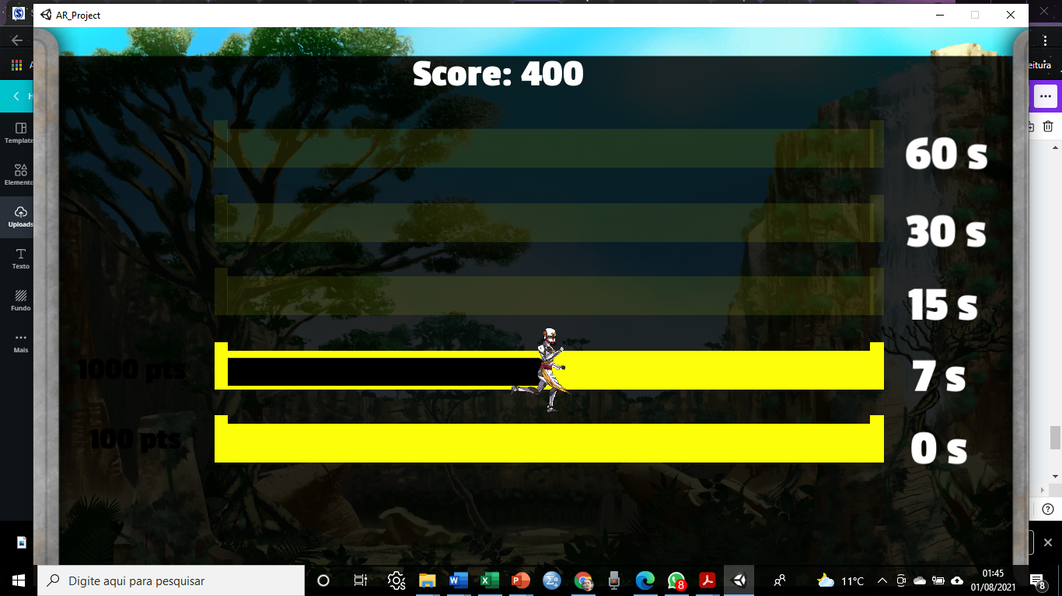
33
Figure 13. (A) Basic instructions for performing the Real Game; (B) Practice screen in which the test-taker is instructed to choose between an immediate lower score (100) or wait 7 s to receive the highest score and thus increase the chances of the total score being converted into a better material prize.

Slide 36

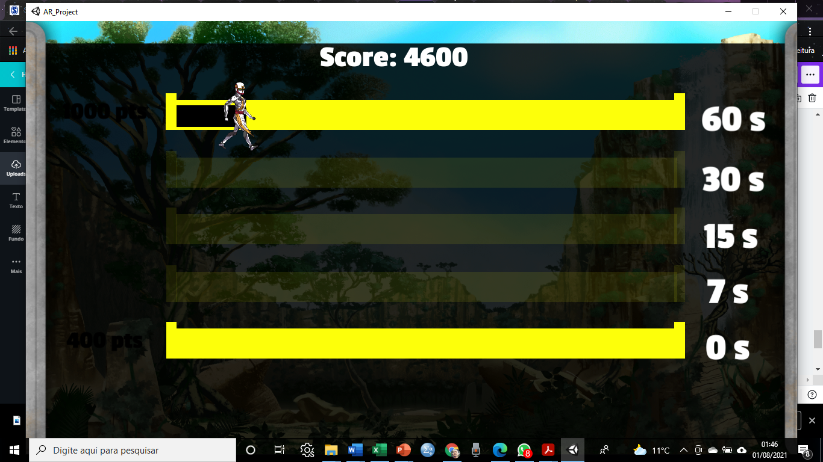

34
After practicing, the first Real Game screen appears, and it is essential to ensure that test-takers understand their task. If necessary, repeat the instructions in a different way. Then, remind test-takers that they WILL receive a material reward at the end of the game (Figure 14A). At this point, the examiner can say:
“Now that you have practiced, you can play the game. Remember, in this game, you WILL receive a real prize based on the points you accumulate. You can start.”
A screen similar to the one shown in Figure 14B then appears. All games have the same layout, but unlike Imaginary Game, here the avatar is visible. After 36 trials, a screen appears displaying the total score achieved in the game (Figure 14C).
A
B
Figure 14. Real Game test step sequence. (A) Screen that informs that the Real Game will start and that the test-taker will receive a material reward.
(B) Different from the Imaginary Game, the avatar appears in this game. The option is given between waiting 60 seconds to receive the highest score (1000) and receiving 400 points immediately.
C
(C) Final screen displaying the final score. At the end of all games, the score in this game is converted proportionally into a real prize.

Slide 37
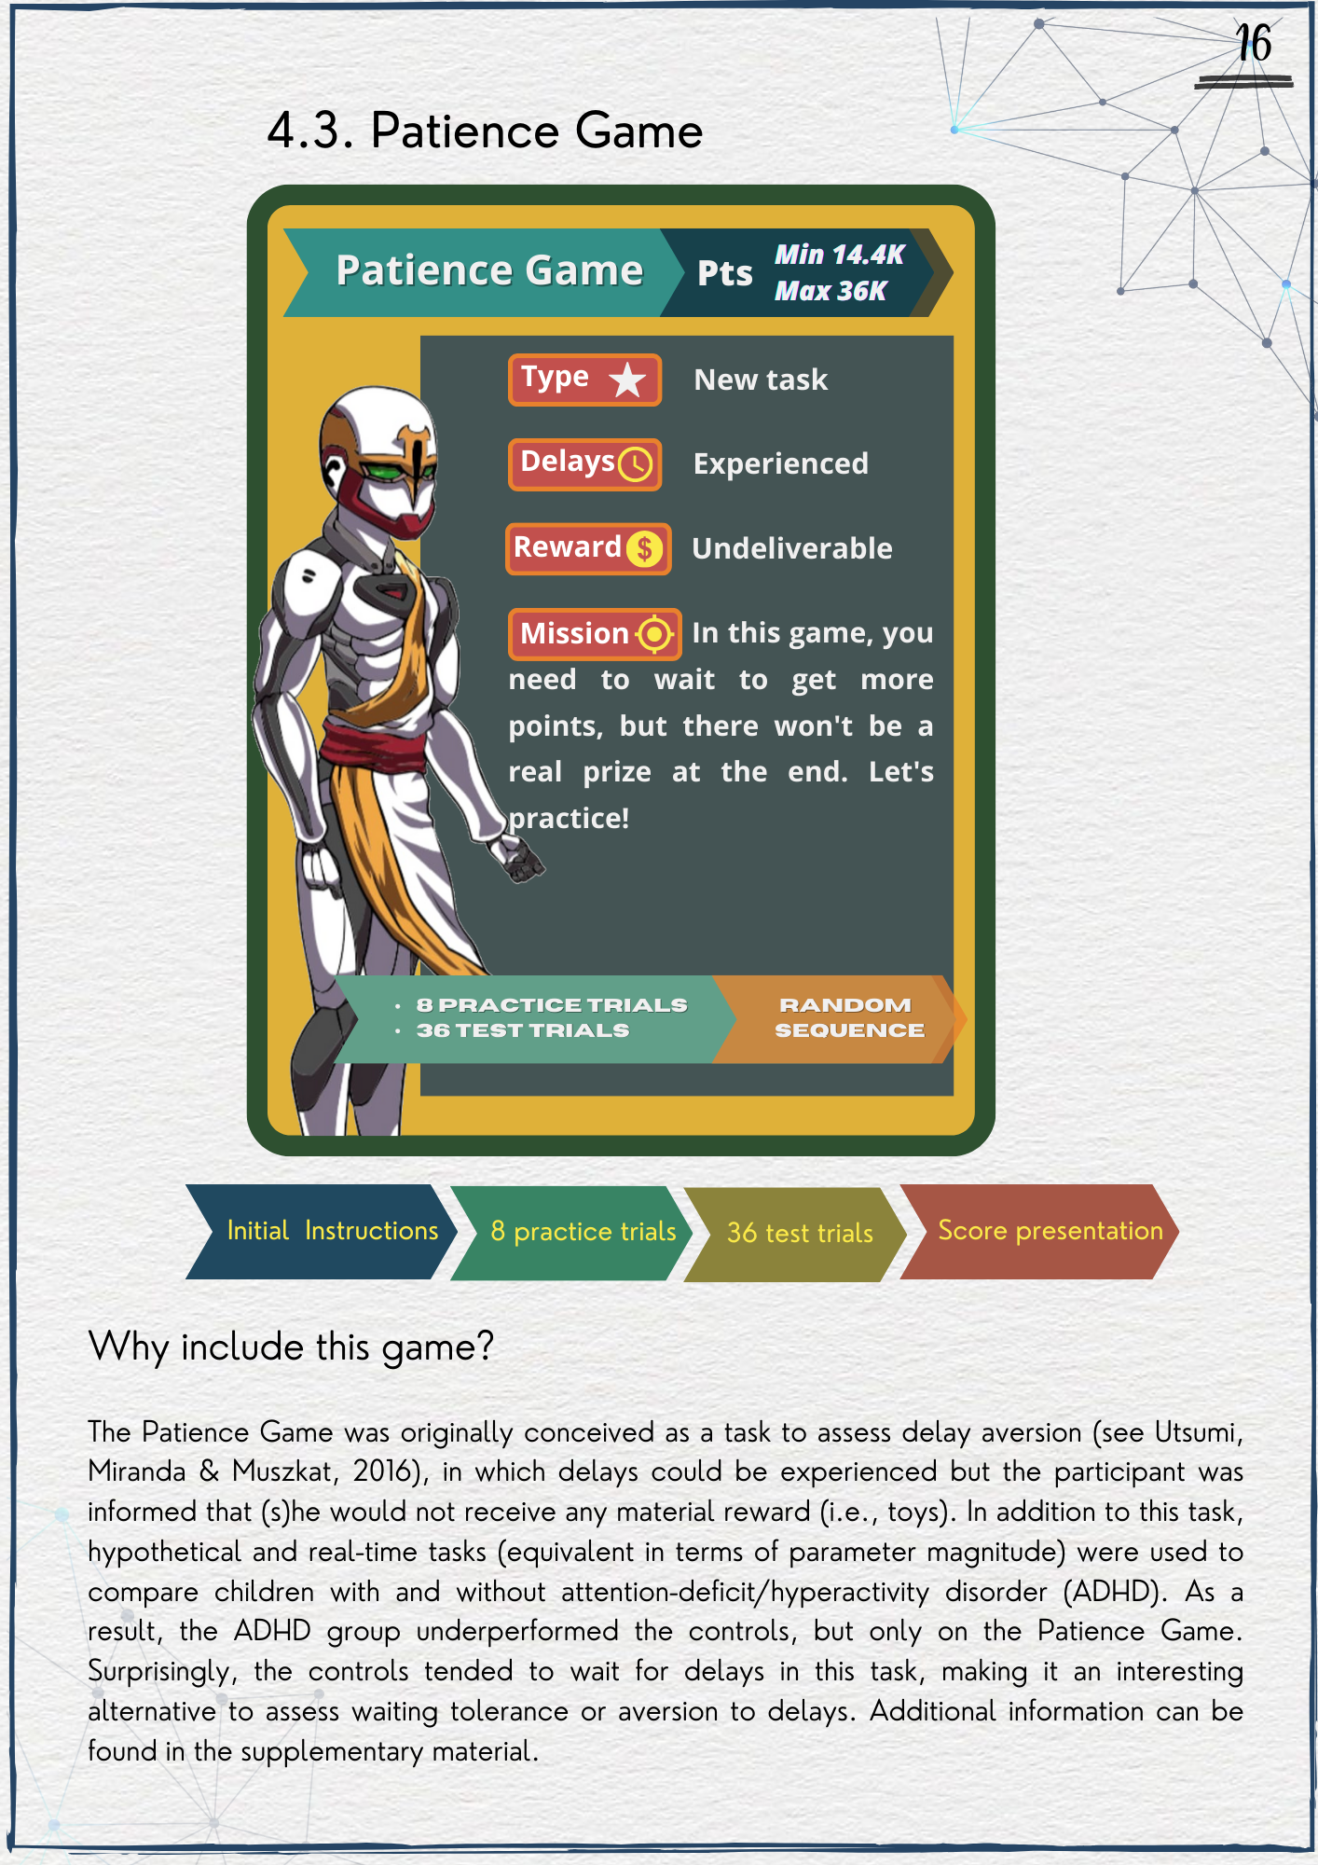
35
4.3. Patience Game (real delays, hypothetical rewards)
Why include this game?
The Patience Game is another type of DD task in which delays can be experienced, but no material reward is delivered. It was developed based on a previous study to assess aversion to waiting (Utsumi et al., 2016).

Slide 38
36
In Utsumi et al. (2016), typically developing children demonstrated superior performance compared to children with attention-deficit/hyperactivity disorder (ADHD) specifically in a game resembling the Patience Game. Nevertheless, no significant distinctions were observed in the other tasks akin to the Imaginary and Real games detailed earlier, despite all games featuring identical delay durations and reward magnitudes. Furthermore, the Patience task exhibited the sole correlation with the Behavior Rating Inventory of Executive Function (BRIEF): improved performance (or reduced discounting) in this task was linked to lower levels of impulsive traits.
If this game is the first to be presented, you can consider this as supplementary information to complement the instructions:
“In this game, you can choose to wait for different time intervals to accumulate more points, knowing that you won’t receive a material prize at the end of the game. To get more points, you’ll need to wait for some durations, but please remember that there won’t be any material prize. Before the game begins, you will have the opportunity to practice and understand how it works.” (Figure 15A).
If this game is the second or third to be presented, the examiner can say:
"In this game, unlike the last one (or the others), evaluate your willingness to wait for some time intervals to accumulate more points. Here you will NOT receive a real prize, but make the choices as if you were going to receive one. Let’s practice!" (Figure 15A).

Slide 39
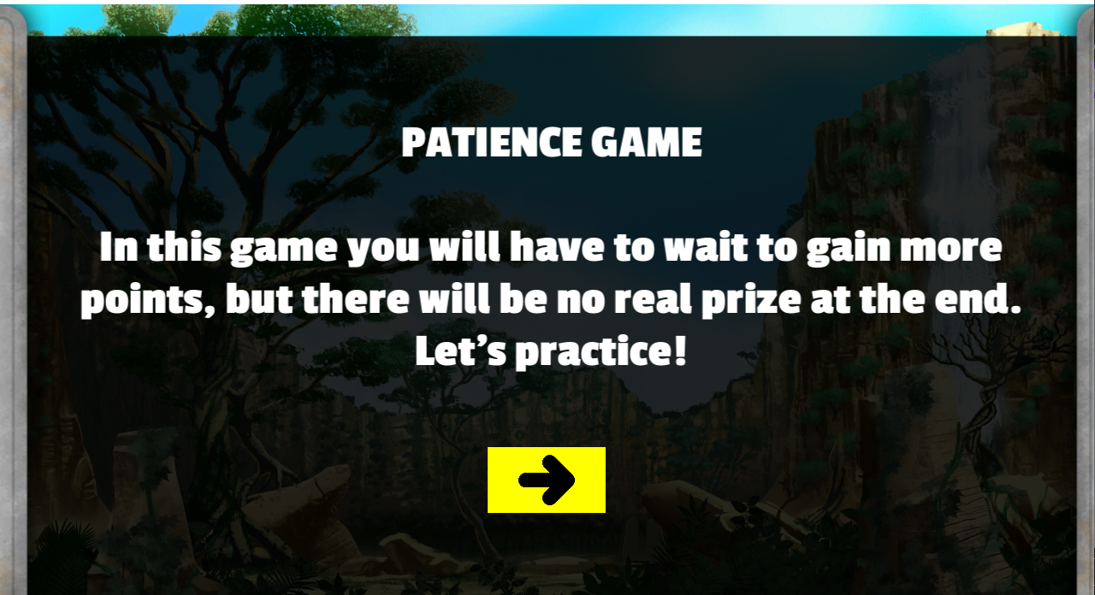
37
Figure 15B shows one of the practice screens. As a way to complement the instructions, the following can be said:
“Now, you are going to practice. You will see screens like this one, where you need to choose if you prefer to wait some time to accumulate a higher score or if you prefer to accumulate a lower score immediately. To make your choice, simply click on the points you want, and they will appear on the scoreboard [point to the scoreboard]. Each time you make a choice, the points will be added to the previous ones and will show up here [on the scoreboard]. See how it works.”
Adopting Figure 15B as an example, you can say:
"Take a look at this screen: we have 700 points here [after choosing, the points are shaded], which you can accumulate now, and 1000 points in this other lane, which you will accumulate after waiting 15 seconds [point to the corresponding lanes]. In this game, if you press that button [corresponding to the larger reward], you will need to really wait for 15 seconds. Remember, in this game you’ll not receive a real prize at the end.”
Even if the test-taker understands the instruction, they may still need encouragement to proceed with the practice trials.
A
B
Figure 15. (A) Fundamental instructions for participating in the Patience Game. (B) Practice screen in which the test-taker is prompted to decide between an immediate lower score (700) or waiting for 15 seconds to receive the highest score, with the awareness that no material reward will be given.

Slide 40

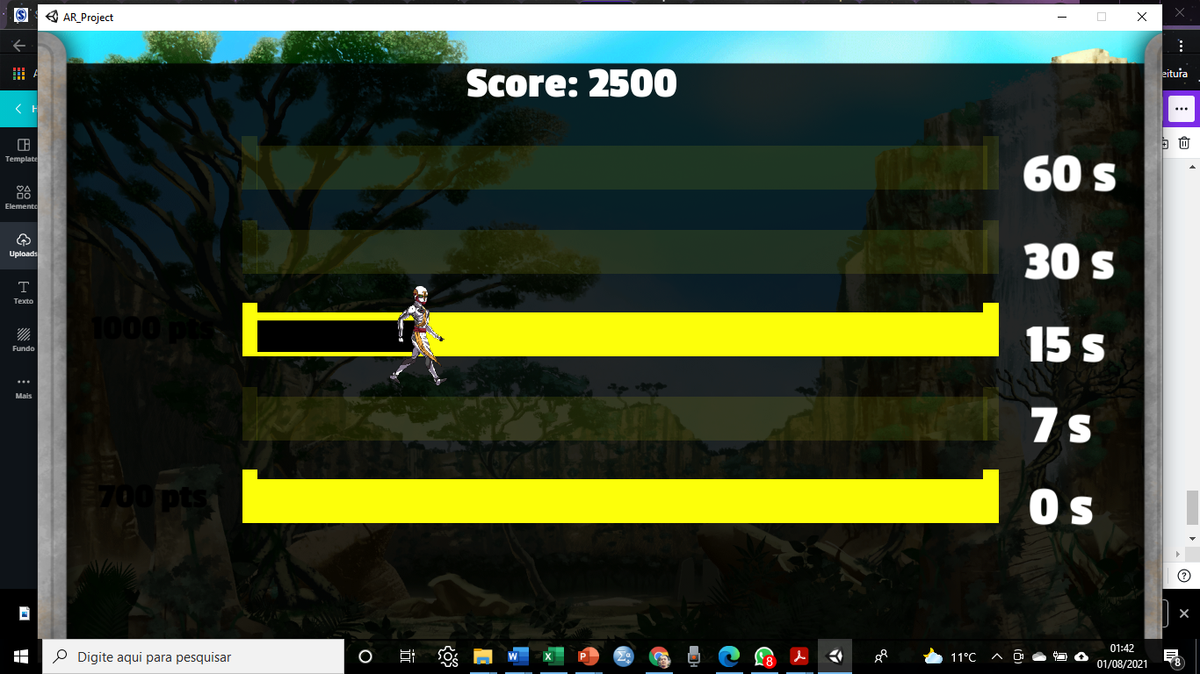

38
After practicing, the first Patience Game screen appears, and it is essential to ensure that the test-takers understand their task. . If necessary, repeat the instructions in a different way. Then, reming the test-takers that they WILL NOT receive a material reward at the end of the game (Figure 16A). At this point, the examiner can say:
“Now that you have practiced, you can play the game. Remember, in this game, you WILL NOT receive a material prize. You can start.”
A screen similar to the one shown in Figure 16B then appears. Visually, the Patience Game is identical to Real Game, with the avatar appearing. After 36 trials a screen appears displaying the total score achieved in the game (Figure 16C).
A
Figure 16. Patience Game test step sequence. (A) Screen that informs that the Patience Game will start and that the test-taker will NOT receive a material reward.
(B) Visually, the Patience Game is identical to the Real Game (the avatar appears). The option is given between waiting 15 s to receive the highest score (1000) and receiving 700 points immediately.
B
C
C) Final screen displaying the final score.

Slide 41

39
4.4. Reward
At the end of the three games, the total and Real Game scores are displayed (Figure 17); the latter is used to determine the material reward received by the participant (see Table 3). The conversion of scores into material rewards was based on a previous study (Utsumi et al., 2016). The total amount to be given to the participant after completing this task followed the guidelines suggested by several authors who conducted real-time tasks, providing a few cents per trial (e.g., Scheres et al., 2014; Yu & Sonuga-Barke, 2016).
Figure 17. Final screen displaying the total scores. The score in the Real Game is then converted proportionally into a material reward determined by the experimenter. The games can be restarted by clicking on the "Restart" button.
Restart
Table 3. Suggestion for converting scoring ranges into monetary rewards.
Scoring range |  | Monetary Value (US$)
28,801 – 36,000 |  | 3.00
21,601 – 23,040 |  | 2.60
14,400 – 21,600 |  | 2.20
Note. In this case, the score delta between the maximum and minimum was equally divided into three ranges, each corresponding to different monetary values. The lowest score range corresponds to a minimum value of US$ 2.20. As the test-taker accumulates more points, the monetary value increases proportionally, in this case, by US$ 0.40.

Slide 42
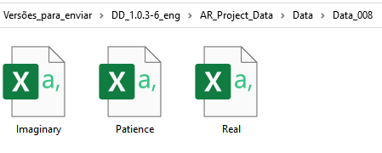
40
5. Output
There are two types of outputs (output 1 and output 2) generated only after the games have been completed. Both outputs are located in the following directory: DD_1.0.3-6 > AR_Project_Data > Data.
5.1. Output 1
This output option is provided for easy visualization of raw data. Each application generates a Data folder identified with three numbers (e.g., Data_000), inside of which there are three CSV files, one for each game (Figure 18). When opening one of the CSV files, it is necessary to separate the information by commas into columns for better visualization. To do this, click on "DATA" in the toolbar, select the data in column A, and then click "Text to Columns." A dialog box will appear; ensure that the “Delimited" option is selected and click "Next." Then, in the delimiters field, click on the comma option, then "Next," and finally, "Finish" (Figure 19).
Figure 18. Location of output 1. In this example, the Data_008 folder was opened, which contains three CSV files corresponding to the three games completed by a single test-taker.

Slide 43
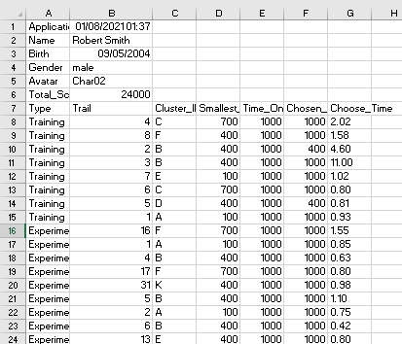
41
Figure 19. Visualization of output 1 data after converting information separated by commas into columns. Each file contains sociodemographic information of the test-taker (name, date of birth, gender, and chosen avatar), date and time of the evaluation, total and partial score of each game, delays, and the time taken between the presentation of the trial and the test-taker’s choice.
Output 1 also allows you to arrange the choices in ascending order. To do this, copy cells A16:G51 and paste them into empty cells (e.g., J1) or another worksheet. Then select the Trial column, click on Sort & Filter in the home toolbar, and choose Smallest to Largest. For those interested, this arrangement will enable the manual construction of a matrix similar to Table 1 (see section 2.1. Methods for obtaining the subjective value), from which the subjective values (regardless of the adopted method) and the areas under the curve of each task can be calculated. However, this is not necessary, as output 2 provides this and other pre-processed data, as will be described below.

Slide 44
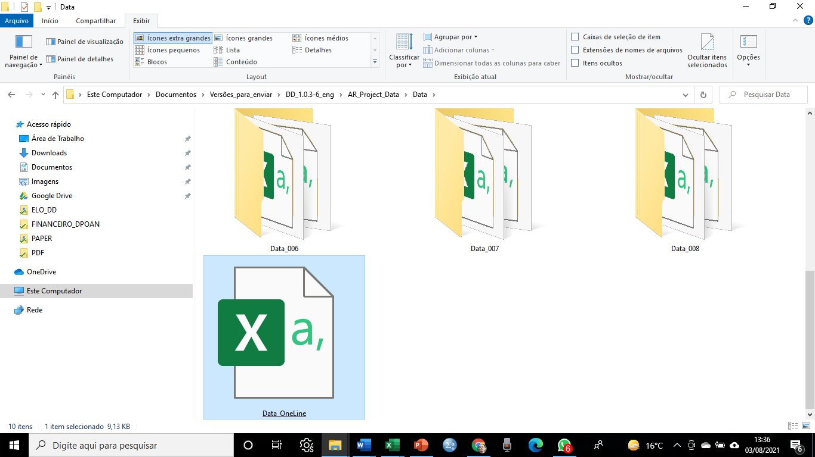
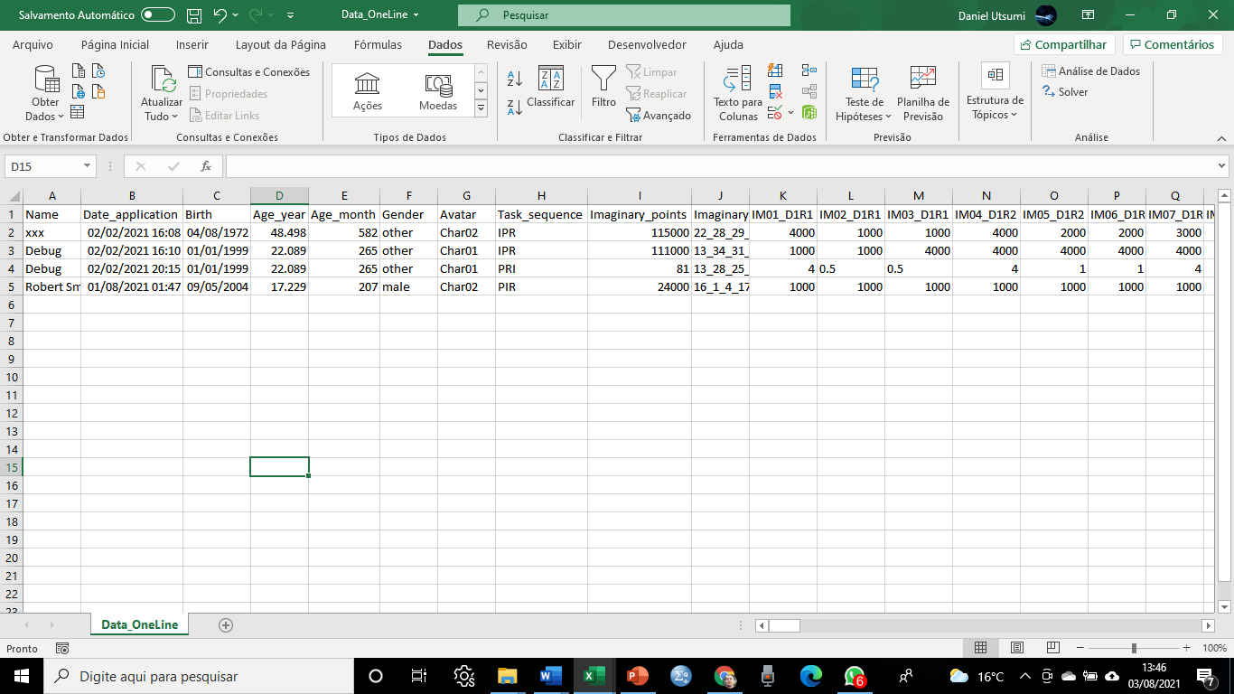
42
5.2. Output 2
The other output option (Output 2, named Data_OneLine) is a single CSV file also located in the Data folder (Figure 20A). It contains all the test-takers’ responses in the three games, organized in one line per test-taker. With each new administration, a line is added immediately below the first to store information in a format that allows statistical analyses by most programs.
In addition to covering all the data from the first output, this second option automatically calculates the test-takers’ age in years and months, provides the sequence of games, gives absolute and normalized DD indexes of the subjective value (by the proportion method), and the area under the curve (AUC) of each game in one line per test-taker (Figure 20B).
A
(A) Locate the Data_OneLine CSV file in the Data folder; (B) As mentioned earlier, you need to split the comma-separated information into columns. This output stores the information in a format that facilitates the transposition of raw data to the database. Note that on line 4, "Debug" is written, indicating the game's abbreviated presentation mode, as described in section 6.6. Debug. Also, observe that cells K4 to M4 have different option values as they were modified using the user interface, which will be discussed later.
B
Figure 20. Location and opening of output 2.

Slide 45
43
Table 4 provides the abbreviations and their corresponding meanings for Output 2 (Data_OneLine).
Table 4. Abbreviations and their meanings of the Output Data_OneLine
Initials | Meaning
I or IM | Imaginary Game (hypothetical task)
P or PT | Patience Game
R or RL | Real Game (real-time task)
IMnumb₁_Dnumb₂Rnumb₃ (e.g., IM01_D1R1) | D = delays; R =reward ; Numb₁ = numerical position in ascending order; Numb₂ = delay ID (e.g., 1 = 7s, 2 = 15s; 3 = 30s; 4 = 60s); Numb₃ = reward ID (e.g., 1 = 100 points, 2 = 400 points, 3 = 700 points).
PTnumb₁_Dnumb₂Rnumb₃ (e.g., PT01_D1R1)
RLnumb₁_Dnumb₂Rnumb₃ (e.g., RL01_D1R1)
IMSVnumb / PTSVnumb / RLSVnumb | SV = subjective value; numb = represents the SV score according to a specific time (e.g., 0 = SV in time zero, 1 = SV in time 7s, 2 = SV in time 15s, 3 = SV in time 30s, 4 = SV in time 60s).
IMSV_N / PTSV_N / RLSV_N | N = normalized subjective value score.
IMAUC / PTAUC / RLAUC | AUC = area under the curve.
IMAUC_N / PTAUC_N / RLAUC_N | N = normalized area under the curve score.
IM_time / PT_time / RL_time | Time elapsed between the presentation of an option and the choice made by the participant in a trial.

Slide 46
44
Both output types mentioned so far use the CSV format. If you want to create your own export type, you can do so by creating a new class that extends the IOutput interface, located at Scripts/Output/. This interface provides methods that will be called at the appropriate times when the user completes the game. Here is a breakdown of the key methods in the interface: 1) StartSession and EndSession: These methods should be used for setting up your exporter when a new session starts and ends; 2) SaveUserData and SaveSelectedCharacter: These methods provide more information about the user who will be taking the test; 3) StartExperiments: This method is called when the user finishes the registration process and is about to begin the experiments; 4) SaveExperimentData: For each new experiment completed, the SaveExperimentData function will be called to save the relevant data; and 5) SaveTotalPoints: This method is called to save the total points accumulated.
For an example of how this interface is used, you can refer to the package located at /Scripts/Output/CSV. The CSVAllOutputs class within that package uses a Facade pattern to handle both CSV output modes. The /Scripts/Output/OutputFactory.cs file is where you choose which implementation of IOutput should be used for your specific needs.
5.3. Scoring
The Waiting Game provides two discount measures: the subjective value (SV) and the area under the curve (AUC), which are expressed in both absolute and normalized values in output 2.

Slide 47
45
Subjective values: We adopted the proportion of delayed reward choices method (Mies et al., 2018) for calculation, as described in equation 1. The absolute SV for each delay in the three tasks can be found in cells DT to EH, while the normalized SV can be found in cells EL to EZ (refer to Table 4). A higher SV indicates a lower discount. Normalized SVs offer the advantage of expressing the preference for the larger reward in a given delay as a percentage. For example, if RLSV_N2 in output 2 is 0.85, it means that in the Real Game, the test-taker chose the larger reward in 85% of the trials involving a 7-second delay.
Area under the curve (AUC; Myerson et al., 2001): AUC is calculated using equation 3. The absolute AUC values for the three tasks can be found in cells EI to EK, while the normalized AUC values are located in cells FA to FC (see Table 4). Higher AUC values indicate lower discounting. Normalized AUC values are valuable for interpreting the results as well. For instance, an IMAUC_N of 0.29 implies that in only 29% of all choices made in the Imaginary Game, the test-taker selected the larger reward, indicating a steeper discounting pattern throughout the task.
5.4. Randomization
Games are presented in random order, but the sequence of trials in the spreadsheet follows a pseudo-random order, which is consistent with the order presented to the test-taker. However, the sequence of trials changes with each administration while adhering to two essential rules that are necessary for calculating the DD scores (see the next section):

Slide 48
46
1) The output must allow the raw data to be rearranged in ascending order. This means that choices involving the lowest score (100) and the shortest delay (7 s) will appear first, followed by choices involving the second lowest score (400) and a 7 s delay, and so on;
2) The order of presentation within a set of identical pairs, referred to as a cluster, must be adhered to. Each choice within a cluster is assigned an ID ranging from 1 to 36, and each cluster, denoted by letters, consists of three identical choice pairs. For example, pairs involving 100 points and 7 s are part of cluster A and are assigned IDs from 1 to 3, whereas pairs involving 400 points and 7s belong to cluster B with IDs from 4 to 6. While clusters themselves can be randomized, it is crucial to maintain the ID sequence of the trials within each cluster. This rule is especially important when calculating the subjective value using the predetermined rules method, which corresponds to only one of the outputs (Figure 21).
To the best of our knowledge, all studies involving tasks of this nature have employed a fixed pseudo-random presentation mode (Scheres et al., 2010a). In other words, the presentation appeared to be random but remained consistent for all participants, unlike in the Waiting Game, where it varied.

Slide 49
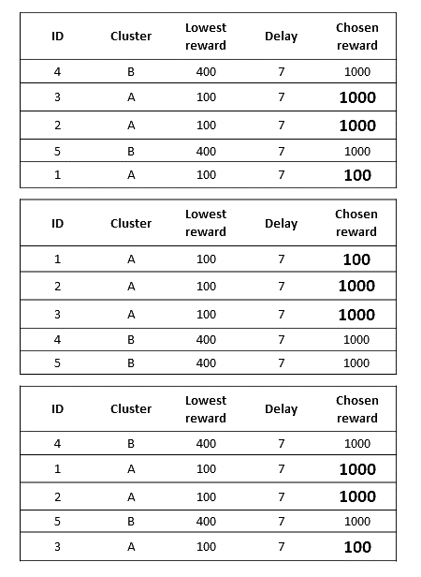
47
A
Figure 21. In a genuinely randomization system, a sequence like the one presented in Figure A may occur. However, when reorganizing the IDs in ascending order (B), there is a reversal of positions (highlighted in bold), making it appear as if the test-taker began discounting when, in fact, they only decided in favor of the immediate reward after waiting twice for 7 s to accumulate a total of 2000 points. This reversal alters the subjective value of the reward for a specific delay, as per the predetermined rules method. Hence, it's not possible to completely randomize trials, and the numerical sequence within the cluster cannot ………be
B
C
disrupted, although it is possible to randomize the clusters. Figure C shows an example of pseudo-randomization, where clusters are presented randomly, but the numerical order within each is preserved. Thus, this approach reduces the probability of inversions and misinterpretations.

Slide 50
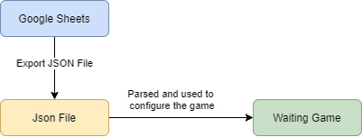
48
6. User Interface
The most practical way to edit the program's content is through Google Sheets (access provided here). Researchers interested in modifying the language/parameters of the program need to create a new version of the spreadsheet to freely edit the contents (see Figure 22). Within this spreadsheet, there are six tabs: Training, Trials, Texts, Rewards, Time, and Debug.
Figure 22. Flowchart illustrating the process of editing the program's content. Edits made in the Google spreadsheet (Domain-Specific Model; DSM) generate a JSON file (Domain-Specific Language; DSL), which should be saved as it serves as the code that replaces the previous one in the Config file, located in AR_Project_Data > StreamingAssets.
Table 5 summarizes the spreadsheet's editable items.

Slide 51
49
Table 5. Editable software items, organized by User Interface tabs (Google Spreadsheets).
Tabs | Editable items |  | Important
Trainings | Immediate prize value: It is possible to select the value and the frequency of occurrence for an immediate reward during the practice trials; Second prize lane: It is possible to modify the lane (delay) in which the higher reward will be presented; Second prize value: The value (4) pertains to the higher reward. It's advised not to alter this value, as an immediate reward will consistently correspond with the higher fixed reward. |  | In all instances, it is not advisable to alter spreadsheet headers and IDs. Both rewards and delays are assigned numerical values. To understand the correlation between these numbers and the corresponding reward amounts and delay durations, refer to the Prizes and Times tabs, respectively.
Experiments | The editable items on this tab are identical to those found in the Trainings tab; however, it is advised not to modify them. This tab serves to display the associations established between immediate rewards and their corresponding delayed counterparts across the 36 trials. Despite the pairings being arranged in ascending order, the program reorders the trial sequence pseudo randomly with each administration. |  | To understand the correlation between numbers and the corresponding reward amounts and delay durations, refer to the Prizes and Times tabs, respectively.
Texts | All text fields are open for editing. When adding a new language, input the corresponding language code in cell A5 and then proceed to translate the text from the available default languages (English, Brazilian Portuguese, and Spanish). You can also modify the reward type. For instance, within columns X, Y, and Z (Score, Points, and Points Abbreviated), you have the option to input "Total Value," "Dollars," and "$," respectively.
Prizes | Value: All values (rewards) can be modified.
Times | Tempo: All delays (measured in seconds) are adjustable; however, it is advisable to refrain from altering the zero time, as it represents the immediate reward. |  | The sequence of lanes should not be modified.
Debug | Always imaginary first: For complete randomization of the three tasks/games, keep the FALSE option selected. If the user wants the Imaginary Game to consistently appear first, type TRUE, and similarly for other preferences. This option permits the use of only one task if desired; Language: Enter the language code to choose the language for the texts.

Slide 52
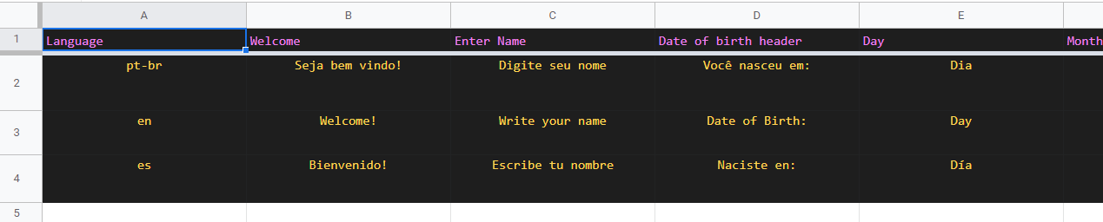

50
To enhance the comprehensibility of the spreadsheet, the tabs will be described in detail below.
6.1. Texts
This tab contains all the text elements that appear during the software's execution (Figure 23). Currently, there are three standard languages: English, Brazilian Portuguese, and Spanish. If needed, these texts can be modified. For example, in this version, the rewards are represented as points, but you can change them to your country's currency. To do so, in columns X, Y, and Z (Score, Points, and Points Abbreviated), you can enter "Total Value," "Dollars," and "$," respectively. Please note that in column A, language codes for these languages are provided (en, pt-br, es). If you wish to add a new language, you should enter the texts in row 5 and insert the language code in column A.
Figure 23. Section of the Texts tab in the software's editing spreadsheet.
Insert a new language in cell A4. Don't forget to enter a new language code (e.g., it for Italian).

Slide 53
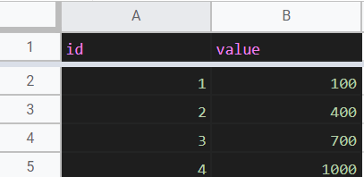
51
6.2. Prizes (rewards)
In this tab the IDs and magnitude (Value) of the rewards are presented (Figure 24). In this version, the rewards are represented as points ranging from 100 to 1000. To make changes, simply enter the new values in cells B2 to B5. Please do not alter the IDs, as they are connected to other tabs.
Do not modify IDs
Figure 24. Prizes tab in the software editing spreadsheet.
6.3. Times (delays)
The Times tab displays the delays (denoted as "tempo" and "pista" in the spreadsheet) for each lane, as shown in Figure 25. There are five lanes, with the first lane representing the immediate reward. Therefore, it is not advisable to alter the time for this lane (set to zero seconds). You can adjust the times for the other lanes, bearing in mind that the unit of measurement is seconds. For instance, if you input 90 in cell B6, it will correspond to 1 minute and 30 seconds. Please refrain from modifying the lane numbers, as they are interconnected with the other tabs.

Slide 54
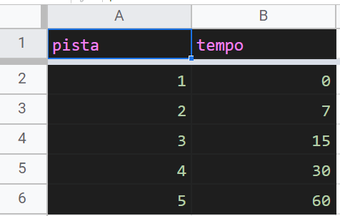
52
Altering this time (zero seconds) is not recommended.
Figure 25. Times tab in the software editing spreadsheet.
6.4. Trainings (practice trials)
On this tab, you can find the IDs and numeric codes for the immediate prize value, the lane in which the immediate prize will appear, and the value of the second prize. It's crucial to keep in mind that the lanes correspond to waiting times: the higher the lane number, the longer the delay (refer to Table 6). While the trial sequence is entirely randomized, you have the flexibility to modify the frequency of prize appearances and the lane associated with the larger prize (as illustrated in Figure 26).
Table 6. Mapping of numerical lane codes to delays in the current software version
Lane | Delays in seconds
1 | 0
2 | 7
3 | 15
4 | 30
5 | 60

Slide 55
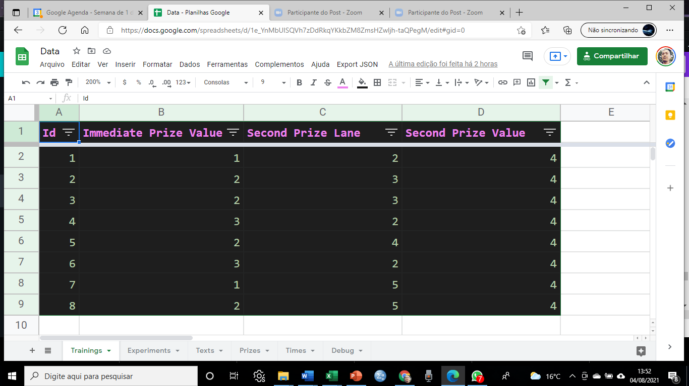
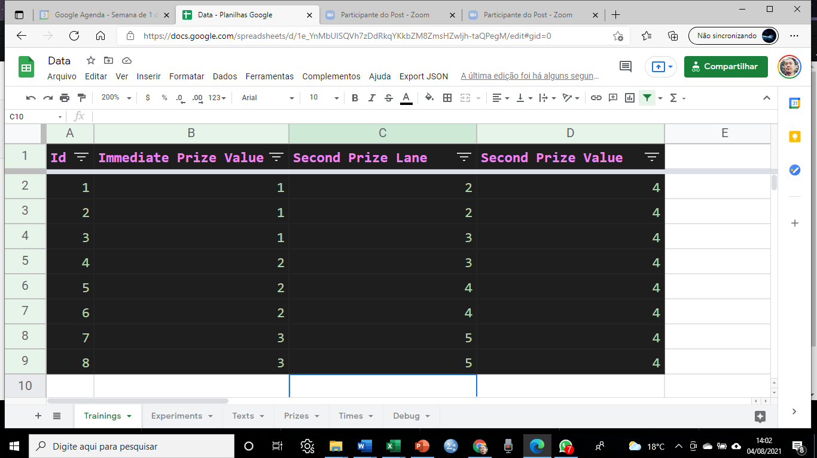
53
Do not modify IDs
Figure 26: The Training (Practice Trial) tab in the software editing spreadsheet, displaying combinations of rewards (immediate and delayed) along with their associated delays for the delayed reward. The highlighted blue square represents a choice between waiting 30 seconds for the maximum value or receiving 100 points immediately.
6.5. Experiments (games/tasks)
This tab contains the same elements as the Training tab but corresponds to the 36 test trials. We strongly advise users not to make any changes to it. Although Figure 27 presents the data organized in ascending order by IDs, the program pseudo-randomizes the sequence of trials while adhering to the scoring rules described above.
Do not modify IDs
Figure 27. Experiments tab displaying the 36 test trials. We advise against altering any of the values.

Slide 56
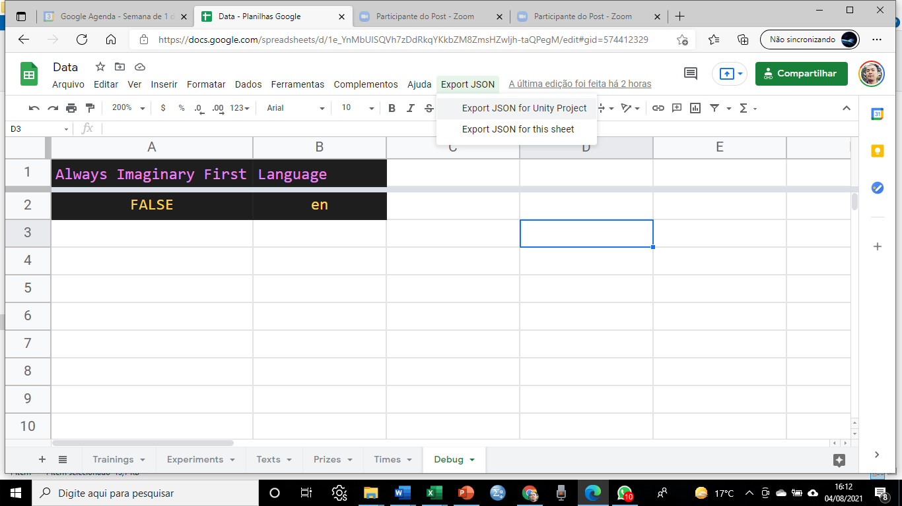
54
6.6. Debug
This tab is crucial for modifying or adding a new language. To achieve this, simply enter the language code in cell B2, ensuring that both the language code and texts are available on the Texts tab. In column A, an option is provided for those who wish to consistently present the Imaginary Game (hypothetical task) first. To enable this, enter "TRUE" in cell A2; otherwise, the tasks will be presented entirely at random (as shown in Figure 28), making automatic scoring unfeasible.
Figure 28. Debug tab.
6.7. JSON Export
Changes made to the Google Spreadsheet are automatically saved. To export and apply these changes, follow these steps: 1) Click on "Export JSON" and then select "Export JSON for Unity Project" (refer to Figure 29A) in the taskbar; 2) A dialog box will appear, displaying the script (Figure 29B). Highlight all the text, then copy it (e.g., by pressing CTRL+C on your keyboard); 3) Navigate to the program's StreamingAssets folder; 4) Open the "Config" file, select all the existing text, and paste the copied script (CTRL+V) into it (as shown in Figure 29C). This will replace the old script with the new one; 5) Save and close the "Config" file.
If you require any assistance, please don't hesitate to contact the authors.

Slide 57
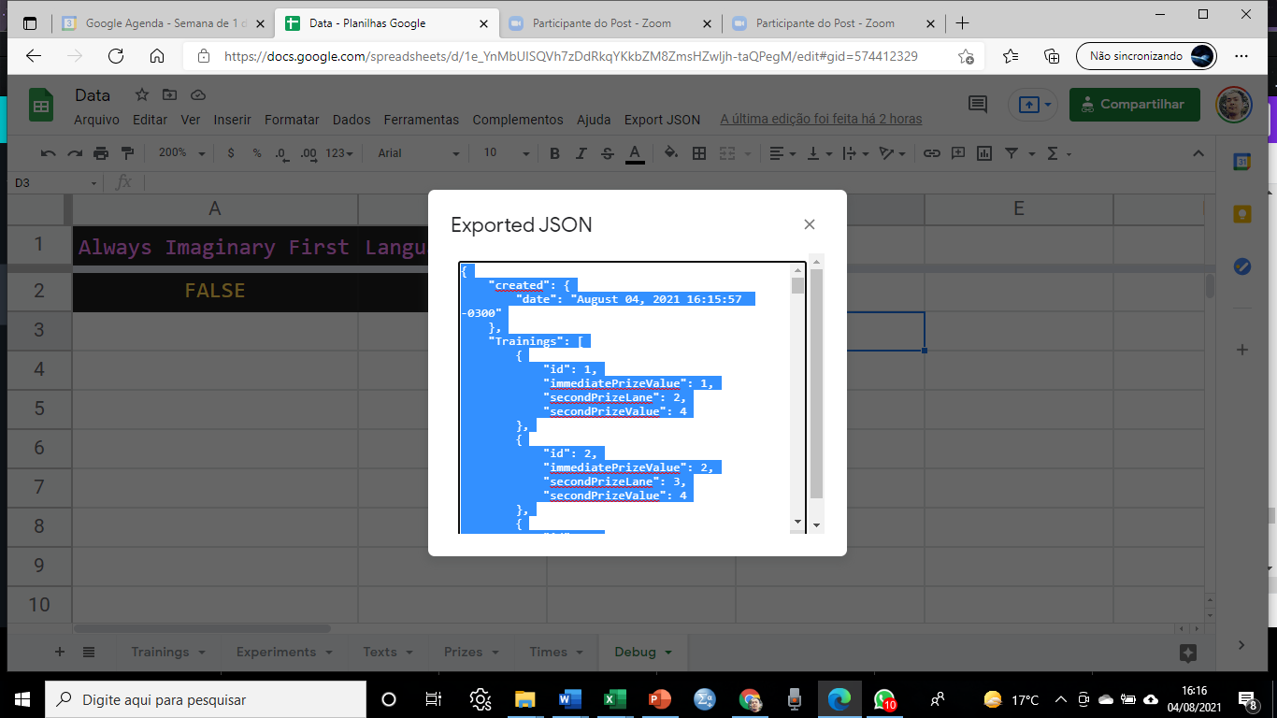
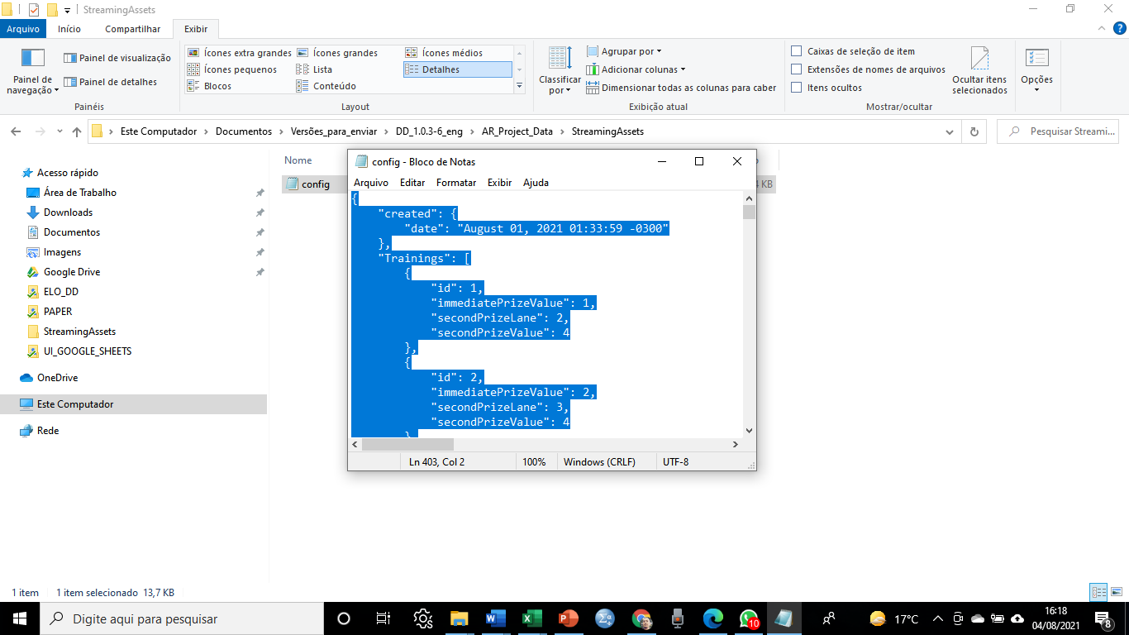
55
Click here
A
B
C
Figure 29. Steps for exporting JSON to the StreamingAssets folder of the software.

Slide 58
56
7. References
Alt, M. (2020). Pure Invention: How Japan's Pop Culture Conquered the World. Crown Publishing Group (NY).
Beck, R. C., & Triplett, M. F. (2009). Test-Retest Reliability of a Group-Administered Paper-Pencil Measure of Delay Discounting. Experimental and Clinical Psychopharmacology, 17(5), 345–355. https://doi.org/10.1037/a0017078
Cerrato, A., & Ponticorvo, M. (2017, June). Enhancing neuropsychological testing with gamification and tangible interfaces: the baking tray task. In International work-conference on the interplay between natural and artificial computation (pp. 147-156). Springer, Cham.
Critchfield, T. S., & Kollins, S. H. (2001). Temporal discounting: basic research and the analysis of socially important behavior. Journal of Applied Behavior Analysis, 34(1), 101–22. http://doi.org/10.1901/jaba.2001.34-101
Demurie, E., Roeyers, H., Baeyens, D., & Sonuga-Barke, E. (2013). Domain-general and domain-specific aspects of temporal discounting in children with ADHD and autism spectrum disorders (ASD): A proof of concept study. Research in Developmental Disabilities, 34(6), 1870–1880. https://doi.org/10.1016/j.ridd.2013.03.011
Deterding, S., Khaled, R., Nacke, L. E., & Dixon, D. (2011, May). Gamification: Toward a definition. In CHI 2011 gamification workshop proceedings (Vol. 12). Vancouver BC, Canada
Edwards, E. J., Edwards, M. S., & Lyvers, M. (2015). Cognitive trait anxiety, situational stress, and mental effort predict shifting efficiency: Implications for attentional control theory. Emotion, 15(3), 350.
Ernst, M. (2014). The triadic model perspective for the study of adolescent motivated behavior. Brain and Cognition, 89, 104–111. https://doi.org/10.1016/j.bandc.2014.01.006
Garrido, M. I., Teng, C. L. J., Taylor, J. A., Rowe, E. G., & Mattingley, J. B. (2016). Surprise responses in the human brain demonstrate statistical learning under high concurrent cognitive demand. npj Science of Learning, 1(1), 1-7. https://doi.org/10.1038/npjscilearn.2016.6

Slide 59
57
Glimcher, P. W., Fehr, E., Camerer, C. F., & Poldrack, R. (2009). Neuroeconomics. In Annu. Rev. Psychol. http://www.sciencedirect.com/science/book/9780123741769
Green, L., Myerson, J., Lichtman, D., Rosen, S., & Fry, A. (1996). Temporal discounting in choice between delayed rewards: The role of age and income. Psychology and Aging, 11(1), 79–84. https://doi.org/10.1037/0882-7974.11.1.79
Hamilton, K. R., Mitchell, M. R., Wing, V. C., Balodis, I. M., Bickel, W. K., Fillmore, M., & Lane, S. D. (2015). Choice Impulsivity: Definitions, Measurement Issues, and Clinical Implications. Personal Disord., 6(2), 182–198. https://doi.org/10.1016/j.physbeh.2017.03.040
Jackson, J. N. S., & Mackillop, J. (2016). Attention-Deficit/Hyperactivity Disorder and Monetary Delay Discounting: A Meta-Analysis of Case-Control Studies. Biological Psychiatry: Cognitive Neuroscience and Neuroimaging, 1(4), 316–325. https://doi.org/10.1016/j.bpsc.2016.01.007
Johnson, M. W., & Bickel, W. K. (2002). Within-subject comparison of real and hypothetical money rewards in delay discounting. Journal of the Experimental Analysis of Behavior, 77(2), 129–146. https://doi.org/10.1901/jeab.2002.77-129
Kahneman, D. (2012). Rápido e devagar: duas formas de pensar. Objetiva
Kelly, S., & Tolvanen, J.P., (2008). Domain-Specific Modeling Enabling Full Code Generation. John Wiley & Sons
Killeen, P. R. (2009). An additive-utility model of delay discounting. Psychological Review, 116(3), 602–619. https://doi.org/10.1037/a0016414
Lagorio, C. H., & Madden, G. J. (2005). Delay discounting of real and hypothetical rewards III: Steady-state assessments, forced-choice trials, and all real rewards. Behavioural Processes, 69(2), 173–187. https://doi.org/10.1016/j.beproc.2005.02.003
Lane, S. D., Cherek, D. R., Pietras, C. J., & Tcheremissine, O. V. (2003). Measurement of delay discounting using trial-by-trial consequences. Behavioural Processes, 64(3), 287–303. https://doi.org/10.1016/S0376-6357(03)00143-8
Lumsden, J., Edwards, E., Lawrence, N. S., Coyle, D., & Munafò, M. (2016). Gamification of cognitive assessment and cognitive training: A systematic review of applications, approaches and efficacy. Front. Public Health, 4.

Slide 60
58
Madden, G. J., Raiff, B. R., Lagorio, C. H., Begotka, A. M., Mueller, A. M., Hehli, D. J., & Wegener, A. A. (2004). Delay discounting of potentially real and hypothetical rewards: II. Between- and within-subject comparisons. Experimental and Clinical Psychopharmacology, 12(4), 251–261. https://doi.org/10.1037/1064-1297.12.4.251
Mahalingam, V., Palkovics, M., Kosinski, M., Cek, I., & Stillwell, D. (2018). A Computer Adaptive Measure of Delay Discounting. Assessment, 25(8), 1036–1055. https://doi.org/10.1177/1073191116680448
Majaw, F. M. (2015). Graphic novels and popular culture. Spectrum: Humanities, Social Sciences and Management, 2, 135-143.
Martin, N. J., & Franzen, M. D. (1989). The effect of anxiety on neuropsychological function. International Journal of Clinical Neuropsychology.
Matusiewicz, A. K., Carter, A. E., Landes, R. D., & Yi, R. (2013). Statistical Equivalence and Test-Retest Reliability of Delay and Probability Discounting Using Real and Hypothetical Rewards. Behav Processes., 100, 116–122. https://doi.org/10.2217/nnm.12.167.Gene
Mazur, J. E. (2000). Tradeoffs among delay, rate, and amount of reinforcement. Behavioural Processes, 49(1), 1–10. https://doi.org/10.1016/S0376-6357(00)00070-X
Mies, G. W., Ma, I., de Water, E., Buitelaar, J. K., & Scheres, A. (2018). Waiting and working for rewards: Attention-Deficit/Hyperactivity Disorder is associated with steeper delay discounting linked to amygdala activation, but not with steeper effort discounting. Cortex, 106, 164–173. https://doi.org/10.1016/j.cortex.2018.05.018
Miller, J. R. (2019). Comparing rapid assessments of delay discounting with real and hypothetical rewards in children. Journal of the Experimental Analysis of Behavior, 111(1), 48–58. https://doi.org/10.1002/jeab.493
Mishra, S., & Lalumière, M. L. (2017). Associations Between Delay Discounting and Risk-Related Behaviors, Traits, Attitudes, and Outcomes. Journal of Behavioral Decision Making, 30(3), 769–781. https://doi.org/10.1002/bdm.2000
Mitchell, S. H., Wilson, V. B., & Karalunas, S. L. (2015). Comparing hyperbolic, delay-amount sensitivity and present- bias models of delay discounting. Behav Processes, 114, 52–62. https://doi.org/10.1161/CIRCRESAHA.116.303790.The

Slide 61
59
Myerson, J., Green, L., & Warusawitharana, M. (2001). Area under the curve as a measure of discounting. Journal of the Experimental Analysis of Behavior, 76(2), 235–243. https://doi.org/10.1901/jeab.2001.76-235
Odum, A. L., Becker, R. J., Haynes, J. M., Galizio, A., Frye, C. C. J., Downey, H., Friedel, J. E., & Perez, D. M. (2020). Delay discounting of different outcomes: Review and theory. Journal of the Experimental Analysis of Behavior, 113(3), 657–679. https://doi.org/10.1002/jeab.589
Patros, C. H. G., Alderson, R. M., Kasper, L. J., Tarle, S. J., Lea, S. E., & Hudec, K. L. (2016). Choice-impulsivity in children and adolescents with attention-deficit/hyperactivity disorder (ADHD): A meta-analytic review. Clinical Psychology Review, 43, 162–174. https://doi.org/10.1016/j.cpr.2015.11.001
Paul, R. H., Lawrence, J., Williams, L. M., Richard, C. C., Cooper, N., & Gordon, E. (2005). Preliminary validity of “integneuroTM”: a new computerized battery of neurocognitive tests. International Journal of Neuroscience, 115(11), 1549-1567.
Peters, J., Miedl, S. F., & Büchel, C. (2012). Formal Comparison of Dual-Parameter Temporal Discounting Models in Controls and Pathological Gamblers. PLoS ONE, 7(11). https://doi.org/10.1371/journal.pone.0047225
Reynolds, B. (2006). A review of delay-discounting research with humans: Relations to drug use and gambling. Behavioural Pharmacology, 17(8), 651–667. https://doi.org/10.1097/FBP.0b013e3280115f99
Reynolds, B., & Schiffbauer, R. (2005). Delay of Gratification and Delay Discounting: A unifying feedback model of delay-related impulsive behavior. Psychological Record, 55(3), 439–460. https://doi.org/10.1007/BF03395520
Robertson, S. H., & Rasmussen, E. B. (2018). Comparison of potentially real versus hypothetical food outcomes in delay and probability discounting tasks. Behavioural Processes, 149(August 2017), 8–15. https://doi.org/10.1016/j.beproc.2018.01.014
Rozema, R. (2015). Manga and the autistic mind. English Journal, 60-68. https://www.jstor.org/stable/24484486
Sailer, M., Ulrich, J., Katharina, S., & Mandl, H. (2017). Computers in Human Behavior How gamification motivates: An experimental study of the effects of specific game design elements on psychological need satisfaction. Computers in Human Behavior, 69, 371–380. http://doi.org/10.1016/j.chb.2016.12.03

Slide 62
60
Scheres, A., Dijkstra, M., Ainslie, E., Balkan, J., Reynolds, B., Sonuga-Barke, E., & Castellanos, F. X. (2006). Temporal and probabilistic discounting of rewards in children and adolescents: effects of age and ADHD symptoms. Neuropsychologia, 44(11), 2092–2103. https://doi.org/10.1016/j.neuropsychologia.2005.10.012
Scheres, A., Lee, A, & Sumiya, M. (2008). Temporal reward discounting and ADHD: task and symptom specific effects. Journal of Neural Transmission (Vienna, Austria : 1996), 115(2), 221–6. http://doi.org/10.1007/s00702-007-0813-6
Scheres, A., Sumiya, M., & Thoeny, A. L. E. E. (2010a). Studying the relation between temporal reward discounting tasks used in populations with ADHD : A factor analysis. 19(April), 167–176. https://doi.org/10.1002/mpr
Scheres, A., Tontsch, C., Thoeny, A. L., & Kaczkurkin, A. (2010b). Temporal reward discounting in attention-deficit/hyperactivity disorder: the contribution of symptom domains, reward magnitude, and session length. Biological Psychiatry, 67(7), 641–648. https://doi.org/10.1016/j.biopsych.2009.10.033
Scheres, A., Tontsch, C., Thoeny, A. L., & Sumiya, M. (2014). Temporal reward discounting in children, adolescents, and emerging adults during an experiential task. Frontiers in Psychology, 5(JUL). https://doi.org/10.3389/fpsyg.2014.00711
Schneider, W. (1991). Equipment is cheap, but the field must develop and support common software for psychological research. Behavior Research Methods, Instruments, & Computers, 23(2), 114-116.
Smith, C. L., & Hantula, D. A. (2008). Methodological considerations in the study of delay discounting in intertemporal choice: A comparison of tasks and modes. Behavior Research Methods, 40(4), 940–953. https://doi.org/10.3758/BRM.40.4.940
Staubitz, J. L., Lloyd, B. P., & Reed, D. D. (2018). A Summary of Methods for Measuring Delay Discounting in Young Children. Psychological Record, 68(2), 239–253. https://doi.org/10.1007/s40732-018-0292-1
Stevens, J. R. (2010). Intertemporal Choice. Encyclopedia of Animal Behavior, 2, 203–208. https://doi.org/10.1002/9780470752937.ch21
Stevens, L., Roeyers, H., Dom, G., Joos, L., & Vanderplasschen, W. (2015). Impulsivity in cocaine-dependent individuals with and without attention-deficit/hyperactivity disorder. European Addiction Research, 21(3), 131–143. https://doi.org/10.1159/000369008

Slide 63
61
Tesch, A. D., & Sanfey, A. G. (2008). Models and methods in delay discounting. Annals of the New York Academy of Sciences, 1128(Dd), 90–94. https://doi.org/10.1196/annals.1399.010
Trepte, S., & Reinecke, L. (2010). Avatar creation and video game enjoyment: Effects of life-satisfaction, game competitiveness, and identification with the avatar.Journal of Media Psychology: Theories, Methods, and Applications, 22(4), 171–184. https://doi.org/10.1027/1864-1105/a000022
Turan, Z., Avinc, Z., Kara, K., & Goktas, Y. (2006). Gamification and Education: Achievements, Cognitive Loads, and Views of Students, 64–69.
Utsumi, D. A., Miranda, M. C., & Muszkat, M. (2016). Temporal discounting and emotional self-regulation in children with attention-deficit/hyperactivity disorder. Psychiatry Research, 246(April), 730–737. https://doi.org/10.1016/j.psychres.2016.10.056
van den Bos, W., & McClure, S. M. (2013). Towards a general model of temporal discounting. Journal of the Experimental Analysis of Behavior, 99(1), 58–73. https://doi.org/10.1002/jeab.6
Yu, X., & Sonuga-Barke, E. (2016). Childhood ADHD and Delayed Reinforcement: A Direct Comparison of Performance on Hypothetical and Real-Time Delay Tasks\r\n. Journal of Attention Disorders, 1–9. https://doi.org/10.1177/1087054716661231
Zhu, M., & Wang A. I. (2019). Model-driven Game Development: A Literature Review. ACM Comput. Surv. (CSUR), 52(6), 1-32

Slide 64
62
Apendix A - Instructions for online administration
The administration of the Waiting Game can be conducted remotely. To do so, it is essential to ensure that both the researcher and the test-taker have:
1) An internet connection.
2) A remote conferencing application installed that supports screen sharing (e.g., Zoom and Google Meet). For researchers, the application account must permit meetings longer than 30 minutes.
3) A compatible operating system (Windows, Linux, and macOS).
To ensure the test-taker isn't affected by unstable connections, it is highly recommended to send the software files in advance, allowing them to play the Waiting Game on their personal computer or tablet. The zipped folder, labeled as "DD_1.0.3-6," can be conveniently shared via WhatsApp or email with the test-taker (or their guardian, if they are a minor). If the researcher has made any recent modifications to the software, it is essential to verify that the zipped folder contains all the latest updates.
After this step, provide the test-taker or their guardian with the link to the remote conference through WhatsApp or email. Once the participant joins the virtual room, kindly request them to enable their microphone and, if possible, activate their camera. At this juncture, it is crucial to provide them with general instructions outlining the upcoming activities.

Slide 65
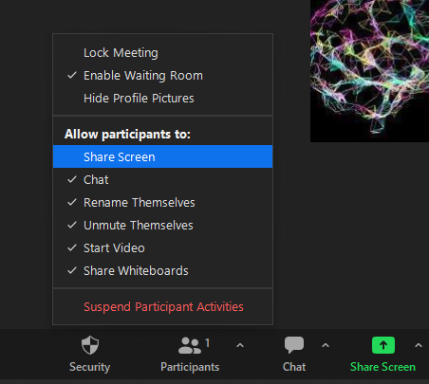
63
To start using the software, grant the test-taker permission to share their screen first. In the Zoom meeting room, the researcher should click on the "Security" icon located in the bottom app bar, then select the option "Allow participant to share screen." Subsequently, instruct the participant to click on the green "Share screen" icon situated at the bottom app bar, followed by clicking "Share" in the lower right corner of the options box (as illustrated in Figure S1). For screen sharing in Google Meet, guide the participant to click on "Present Now" on the bottom app bar and then select "A tab."
Figure S1. Screen Sharing Procedure in Zoom. To begin, the researcher should click on the "Security" icon located in the app's bottom bar and then choose "Share screen." Subsequently, instruct the test-taker to click on the green "Share screen" icon also found in the app's bottom bar, followed by clicking the blue "Share" button within the options box.
Following this, instruct the test-taker or their guardian to unzip the "DD_1.0.3-6" folder. They can do this by right-clicking on the folder and choosing the option "Extract all" or "Extract here," or by using a zip/compression software like 7-Zip or WinZip. Once the folder has been successfully unzipped, it is advisable to rename it for clarity (e.g., "DD" followed by the test-taker's initials). To rename the folder, simply right-click on it and select the "rename" option. Then proceed to follow the administration instructions provided in 4. Games.

Slide 66
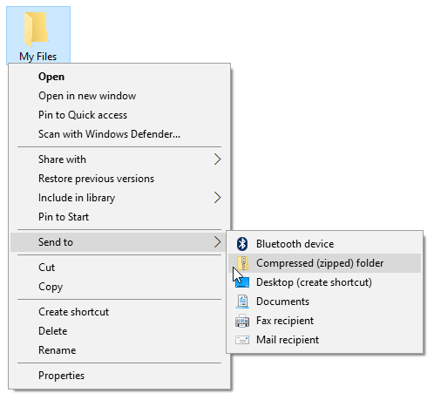
64
At the conclusion of the application, it is crucial for the researcher to assist the test-taker in sending the data output. To accomplish this, provide instructions for accessing the "DD_1.0.3-6" folder > "AR_Project_Data”. Inside this folder, guide the test-taker to compress the "Data" folder by right-clicking it, then selecting "Send To," and finally choosing "Compressed (zipped) Folder." Following the compression, it is advisable to rename the folder using the test-taker's initials. An alternative method is to instruct the test-taker to compress the entire "DD_1.0.3-6" folder, utilizing the same procedure outlined above (as shown in Figure S2). Subsequently, the zipped folder can be conveniently sent via WhatsApp or email.
Figure S2. Instructions for compressing the software folder.
Sending the folder via WhatsApp Web or WhatsApp Desktop is conveniente as it permits the uploading of substantial files without the necessity of generating links or resorting to large file upload websites (which often have file size limits, such as WeTransfer or MailBigFile). Here's how to accomplish this:
1) Instruct the test-taker to access WhatsApp (Web or Desktop) and open the chat with the researcher.
2) In the chat's textbox, guide them to click on the "paperclip" icon and subsequently select the "File" option.
3) Then, direct them to choose the zipped folder and proceed to send it to the researcher (as depicted in Figure S3).

Slide 67
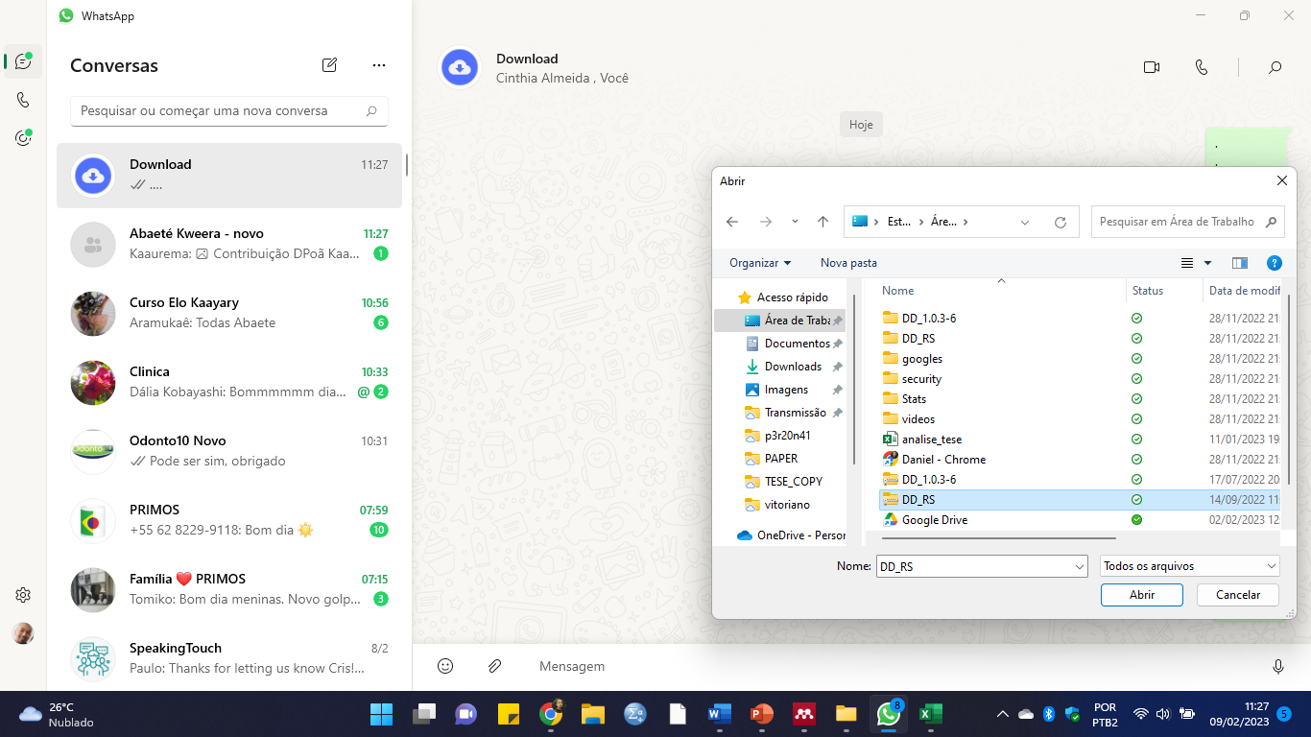
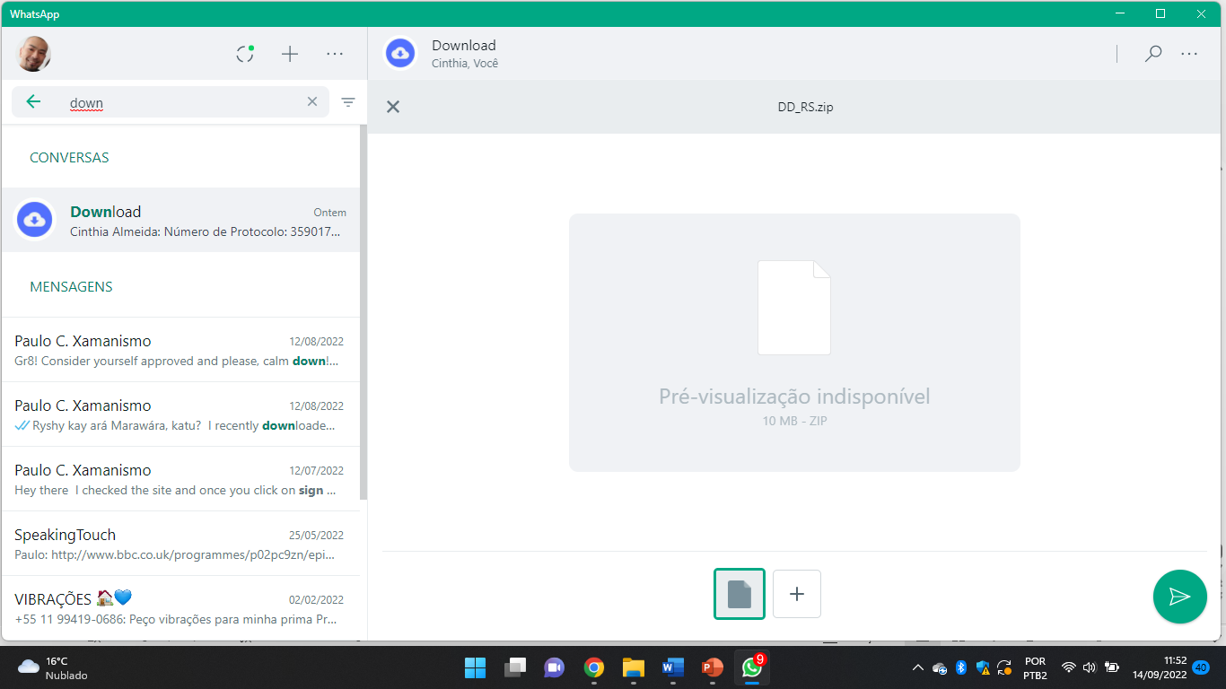
65
A
Select “File”
B
Send
Figure S3. Steps for sending the zipped folder via WhatsApp. (A) Instruct the test-taker to access WhatsApp (Web or Desktop), open the chat with the researcher, and click on the "paperclip" icon, followed by selecting the “File" option. Locate and choose the updated zipped folder (renamed with the test-taker's initials). (B) Verify that the folder name is correct, and then click on the “send” icon.

